Slide 1
PIPEMB, an integrated workflow for a short genomic variant discovery
LBBC – INCA
Rio de Janeiro
2023
Elvismary Molina de Armas (Ema) Prof. Sérgio Lifschitz
PUC-RIO
Mariana Boroni
Nicole Scherer
INCA

Slide 2
Summary
Motivation:
Variant calling workflow. PIPEMB
GATK: Best Practices, GATK and Picard, workflows
WDL + Cromwell
PIPEMB-WDL workflow. Construction process:
WDL coding
Installation
Infrastructure points
Execution:
Input sequence files
JSON file. Common options
Slurm script (command execution)
Execution time, output log (when you know that everything was successful)
Output directory

Slide 3
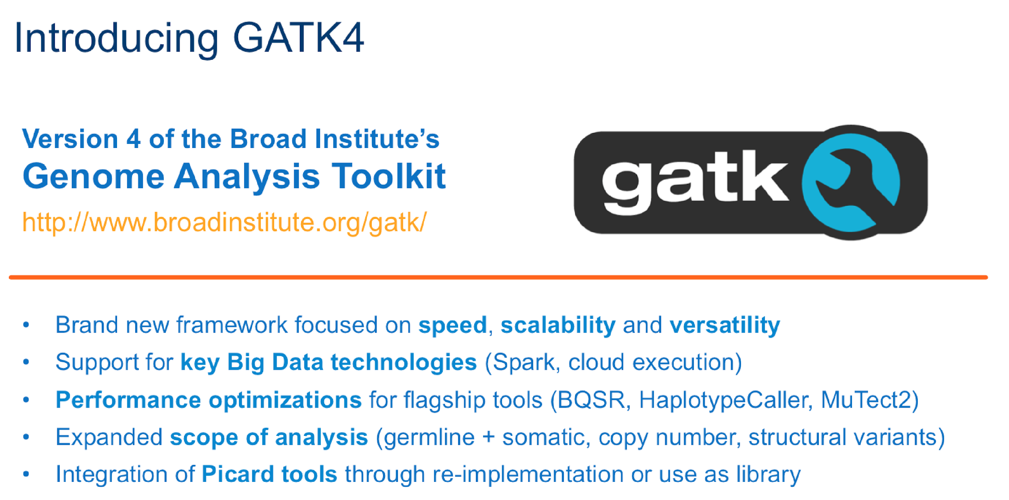
GATK 3. Best Practices
Short variant discovering (SNP and INDEL)
Pre-processing
Variant discovery
Refinement and evaluation
from raw sequence reads (FASTQ files) to aligned reads (BAM files)
from aligned reads (BAM files) to variants (VCF files)
Variant filtering, genotype refinement, functional annotation
Notes:
Tools de ferramentas
Secuencia de passos estableciendo entradas e salidas e ferramentas a serem usadas.
implementãção. (?)

Slide 4
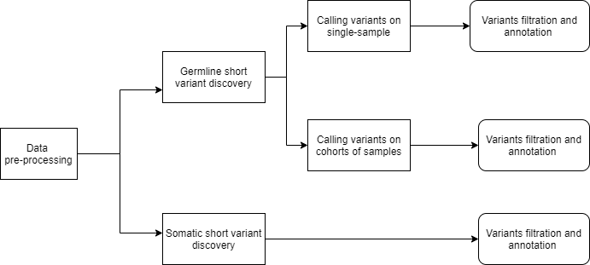
PIPEMB workflow. Main conceptual model.
Short variant discovering (SNP and INDEL)

Slide 5
PIPEMB workflow. Main conceptual model.
Pre-processing
Variant discovery
Refinement and evaluation

Slide 6
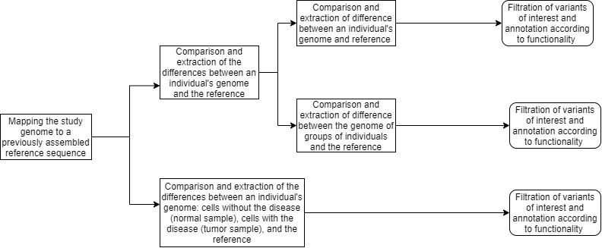
PIPEMB workflow. Main conceptual model.
Pre-processing
Variant discovery
Refinement and evaluation

Slide 7
PIPE-MB (GATK V3). Implementation.
Fastq
BAM
BAM to Fastq
Análise de Qualidade
Fastq to SAM
Marcação de Duplicatas
Alinhamento
uBAM to Fastq
Identificação de Adaptadores
2 amostras (T e N)
Realinhamento de Indels
Recalibração de Bases
Análise de Cobertura
BAM
SIM
MuTect
Anotação do efeito da variante
NÃO
Cohort e WGS
(Mais de 100 amostras)
Snpcall
SIM
filter.sh
NÃO
Source. Slides from ppt of Priscila de Sousa Ferreira
Rio de Janeiro, 18/03/2019
hard_filter.sh
Separando as amostras
Notes:
Germeline e somatico

Slide 8
Notes:
https://gatkforums.broadinstitute.org/gatk/discussion/9644/unboxing-gatk4

Slide 9
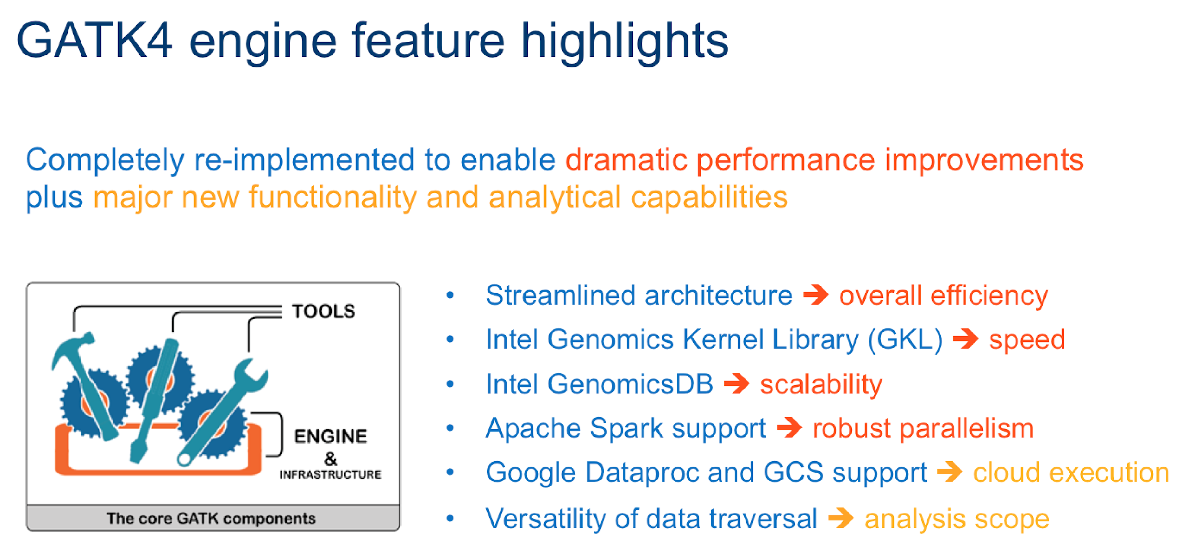

Slide 10
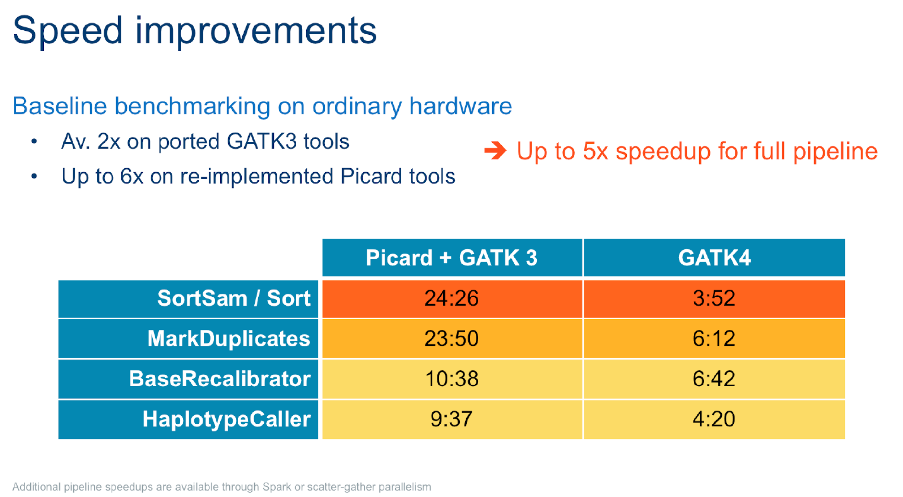

Slide 11
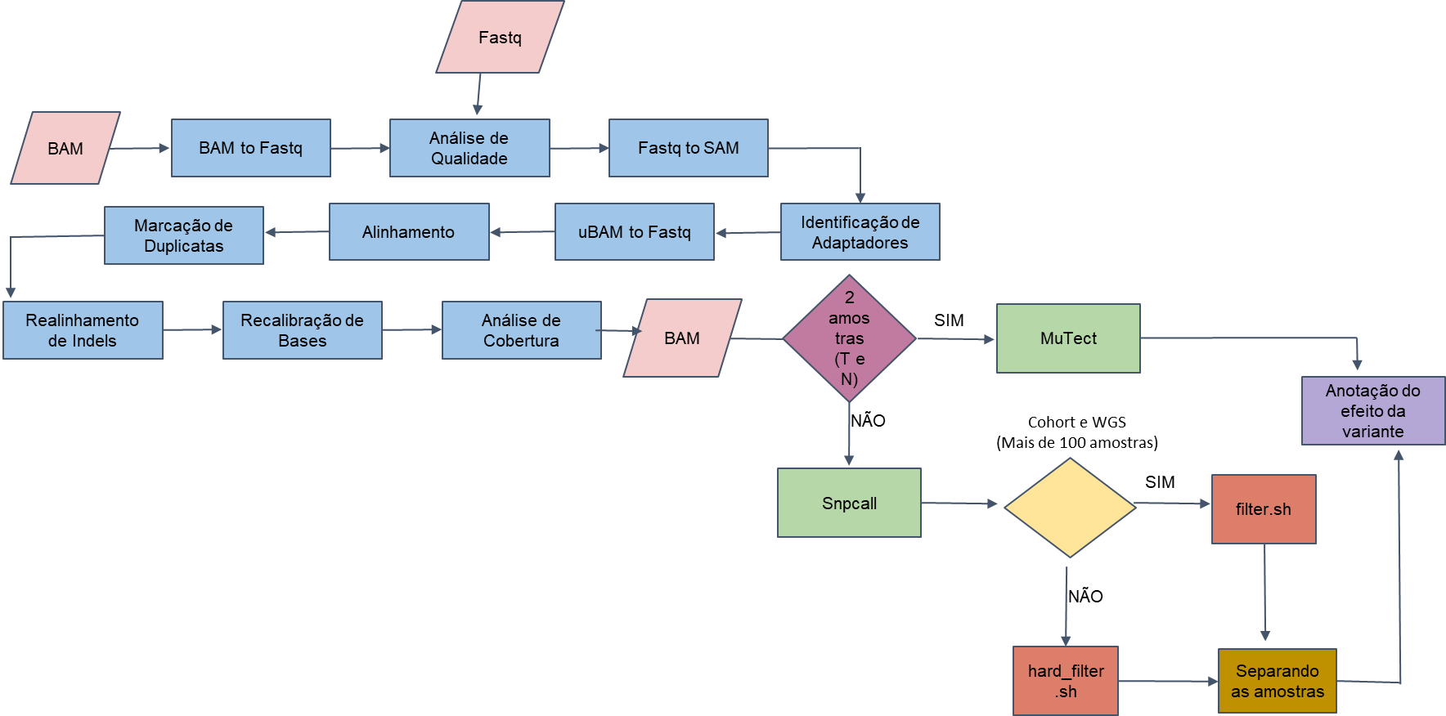
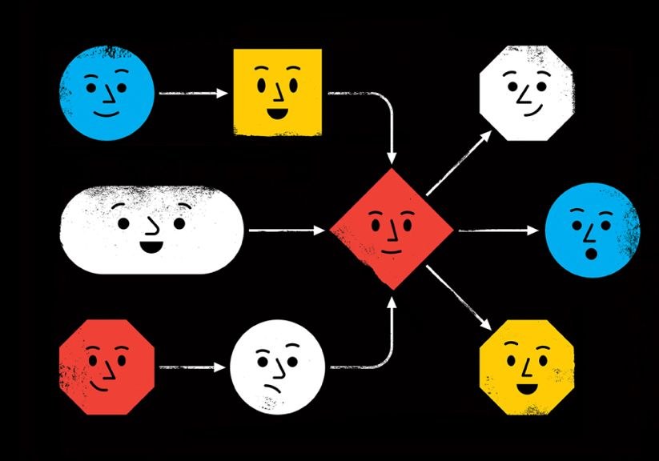

Main motivation
How to?
Be able to take advantage of the improvements in GATK 4.
Reproducible (provenance)
Allow flexibility to adapt to new changes (new versions, new recommendations)
Easy to change tools
Easy to maintenance
Easy to scale
GATK 3
Tools
Best Practices
Tools
Best Practices
Execution infrastructure + Workflow description languague

Slide 12
Workflow Description Language (WDL)
https://github.com/openwdl/wdl/blob/main/versions/1.0/SPEC.md#arrayarraystring-read_tsvstringfile
workflow wf {
input{
}
call hello
{
input:….
}
call task1
{
input:....
}
output{
Array[String] wf_out = hello. matches
}
}
task hello {
input {
String pattern
File in
}
command {
egrep '${pattern}' '${in}'
}
runtime {
docker: "broadinstitute/my_image"
}
output {
Array[String] matches = read_lines(stdout())
}
}
if:
scatter:
Notes:
The Workflow Description Language (WDL) is a way to specify data processing workflows with a human-readable and writeable syntax. WDL makes it straightforward to define complex analysis tasks, chain them together in workflows, and parallelize their execution. The language makes common patterns simple to express, while also admitting uncommon or complicated behavior; and strives to achieve portability not only across execution platforms, but also different types of users. Whether one is an analyst, a programmer, an operator of a production system, or any other sort of user, WDL should be accessible and understandable.

Slide 13
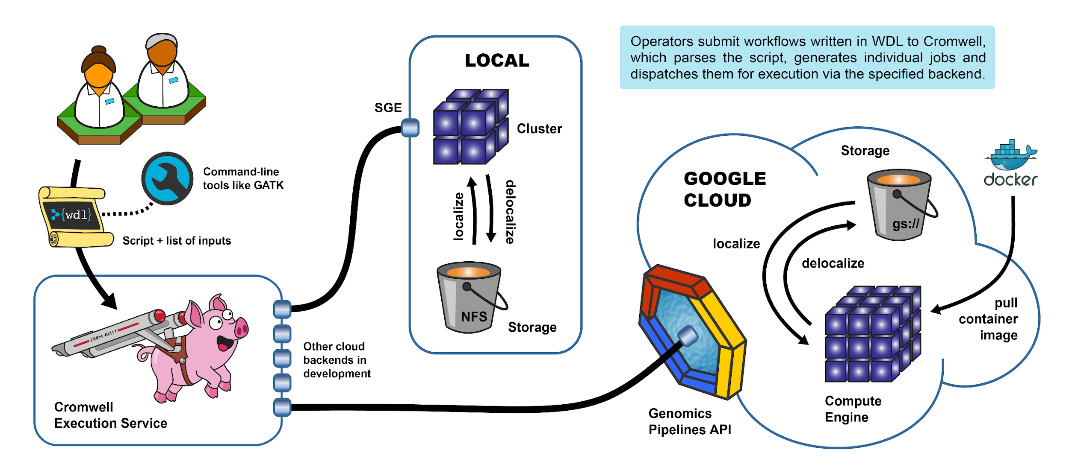
Cromwell + WDL
https://gatk.broadinstitute.org/hc/en-us/articles/360035889771-Pipelining-GATK-with-WDL-and-Cromwell

Slide 14
Summary
Motivation:
Variant calling workflow. PIPEMB
GATK: Best Practices, GATK and Picard, workflows
WDL + Cromwell
PIPEMB-WDL workflow. Construction process.
WDL coding
Installation
Infrastructure points
Execution:
Input sequence files
JSON file. Common options
Slurm script (command execution)
Execution time, output log (when you know that everything was successful)
Output directory

Slide 15
PIPEMB workflow main conceptual model
Pre-processing
Variant discovery
Refinement and evaluation

Slide 16
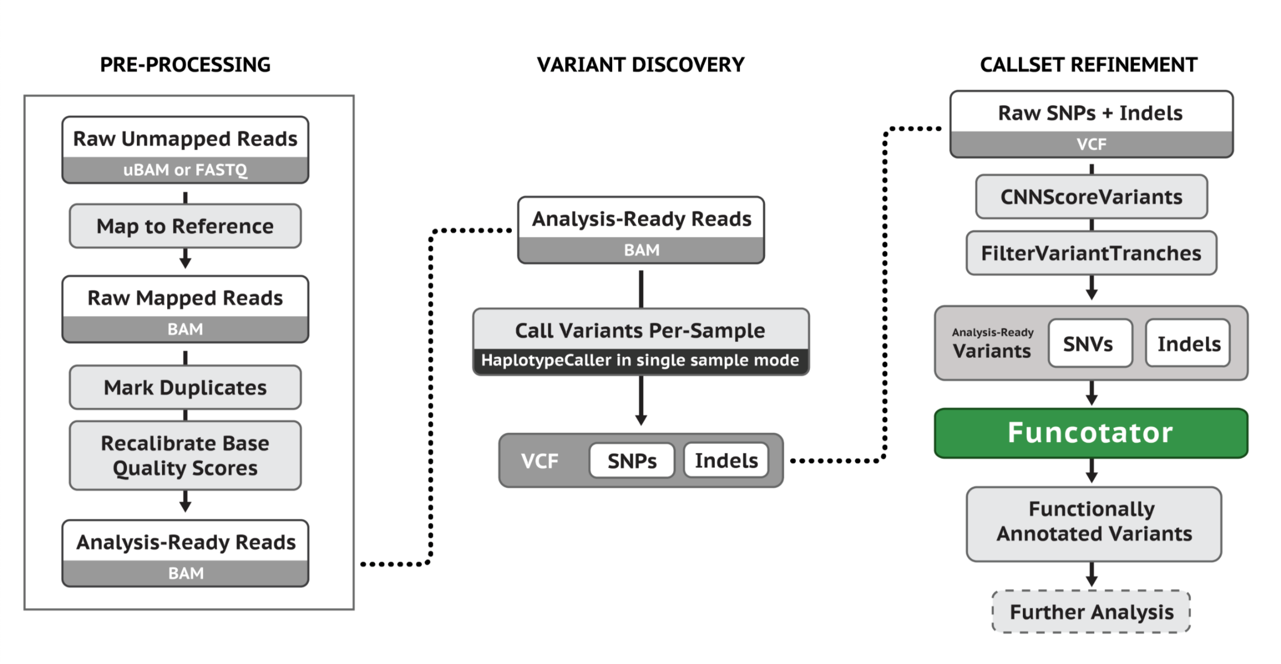
Main steps for Germline Single-Sample Data
https://gatk.broadinstitute.org/hc/en-us/articles/360035535932-Germline-short-variant-discovery-SNPs-Indels-

Slide 17
PIPEMB workflow main conceptual model
Pre-processing
Variant discovery
Refinement and evaluation

Slide 18
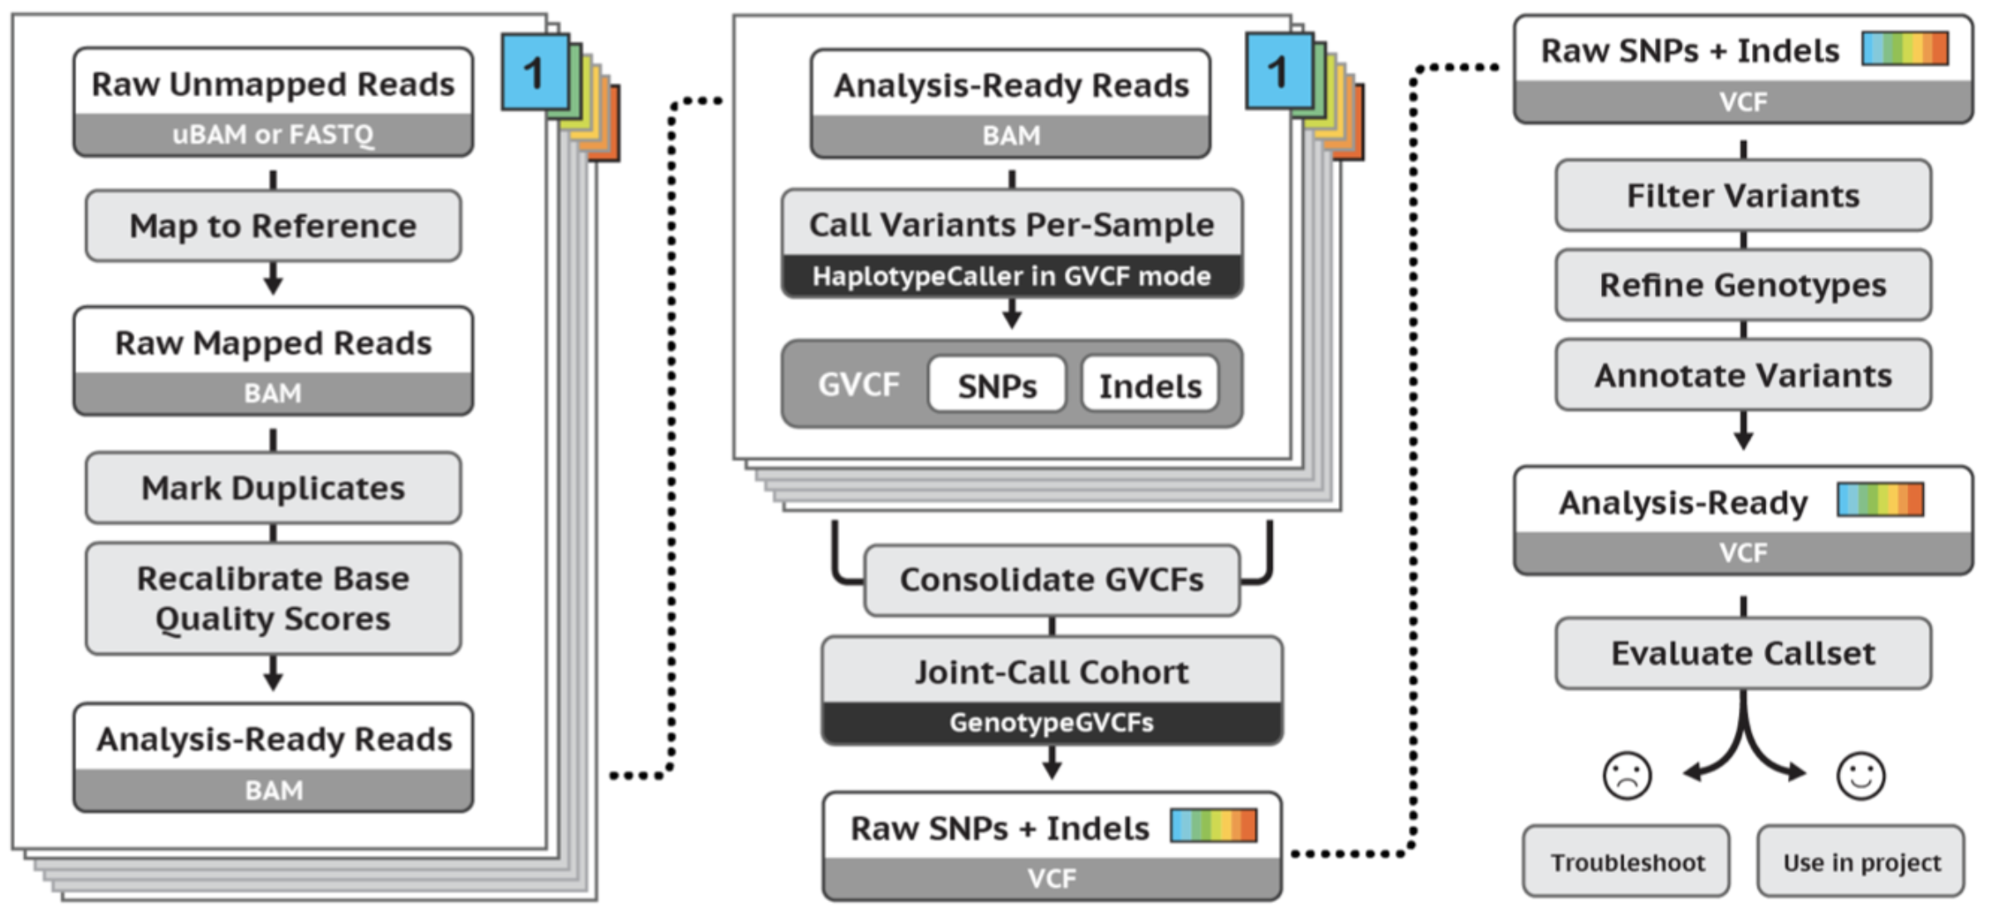
Main steps for Germline Cohort Data
https://gatk.broadinstitute.org/hc/en-us/articles/360035535932-Germline-short-variant-discovery-SNPs-Indels-

Slide 19
PIPEMB workflow main conceptual model
Pre-processing
Variant discovery
Refinement and evaluation

Slide 20
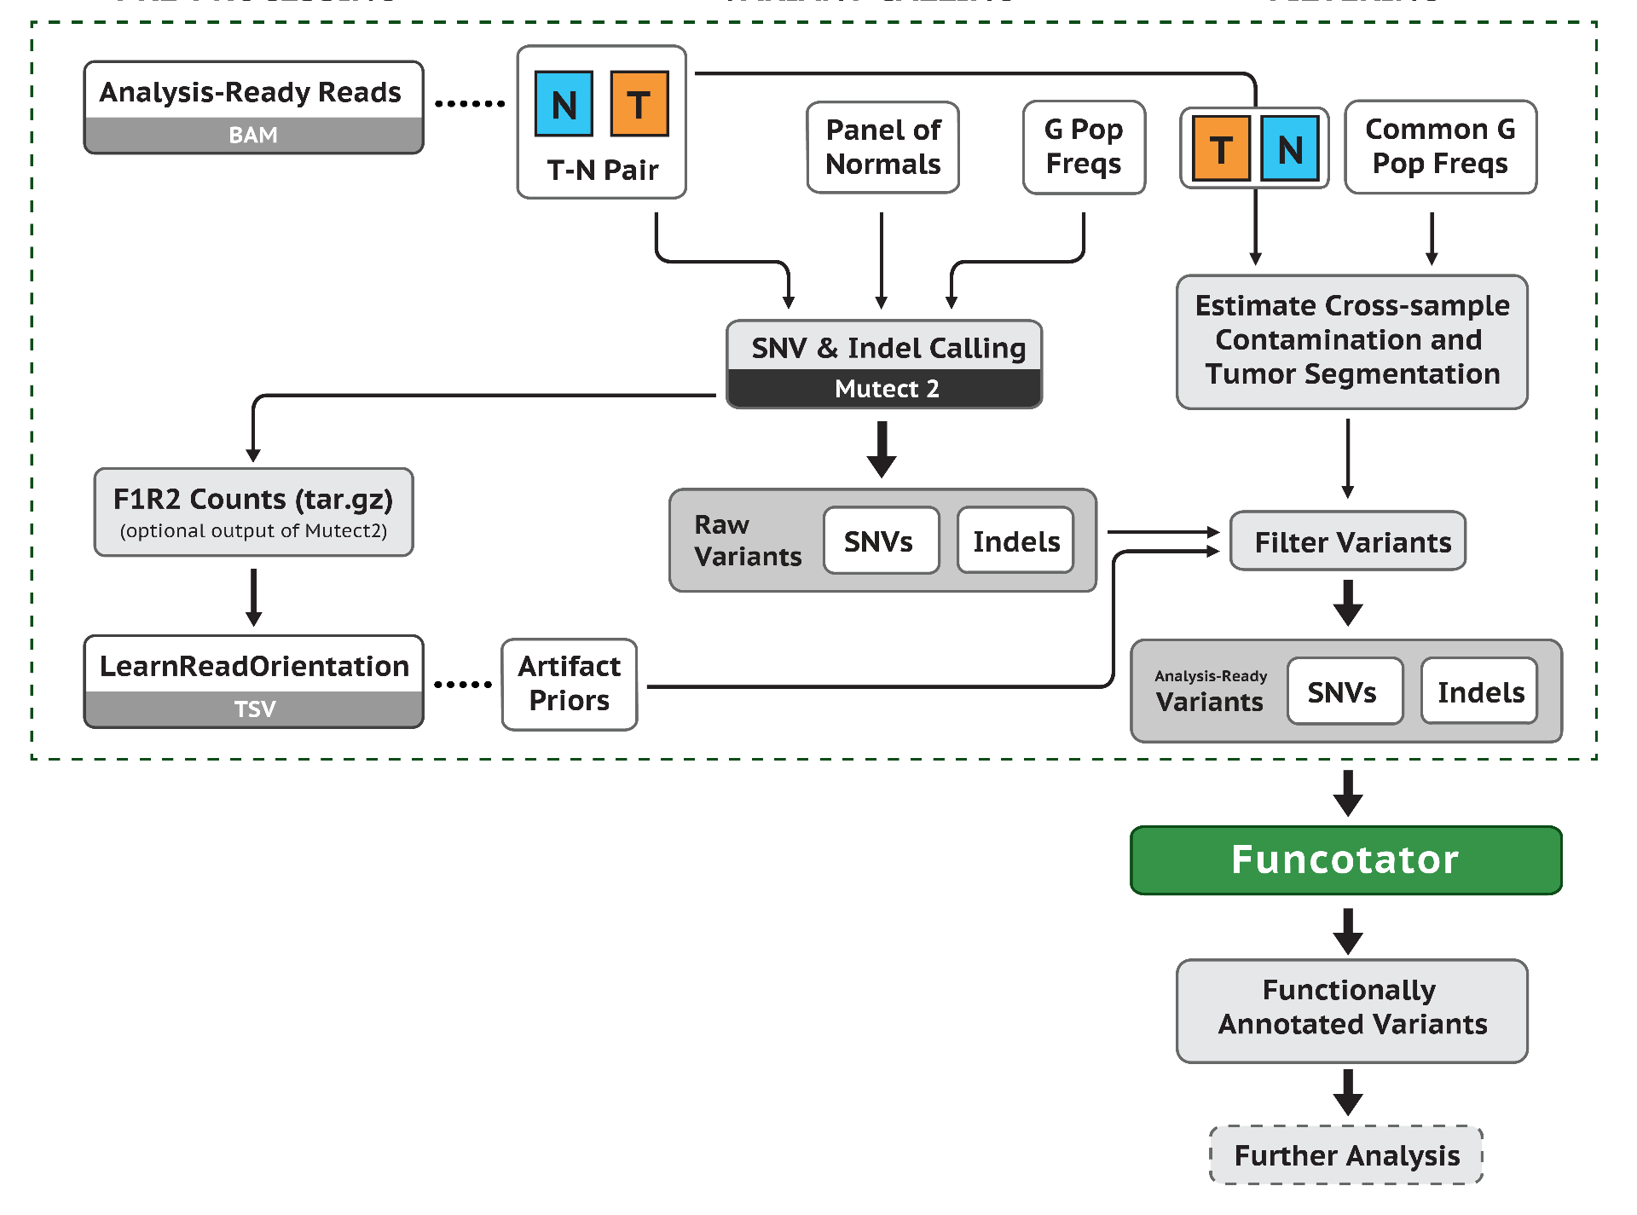
Somatic short variant discovery (SNVs + Indels)
https://gatk.broadinstitute.org/hc/en-us/articles/360035535932-Germline-short-variant-discovery-SNPs-Indels-

Slide 21
Available implementations (GATK workflows)
gatk4-germline-snps-indels.
haplotypecaller.wdl
gatk4-germline-snps-indels.
JointGenotyping.wdl
There is no integration between the different implementations.
Validation is not included in all cases.
Does not take fastq input into account.
Does not include adapter marking.
Multi-sample processing is not automated.
gatk4-data-processing. processing-for-variant-discovery-gatk4.wdl
gatk4-somatic-snvs-indels.
mutect2_pon.wdl
gatk4-somatic-snvs-indels.
mutect2.wdl
Notes:
Nada disso esta conetado

Slide 22
Available implementations (gatk workflows)
n samples
gatk4-germline-snps-indels.
haplotypecaller.wdl
...
There is no integration between the different implementations.
Validation is not included in all cases.
Does not take fastq input into account.
Does not include adapter marking.
Multi-sample processing is not automated.
gatk4-germline-snps-indels.
JointGenotyping.wdl
n executions,
1 per sample
n samples
gatk4-data-processing. processing-for-variant-discovery-gatk4.wdl
n executions,
1 per sample
...
gatk4-somatic-snvs-indels.
mutect2_pon.wdl
gatk4-somatic-snvs-indels.
mutect2.wdl
Notes:
Nada disso esta conetado

Slide 23
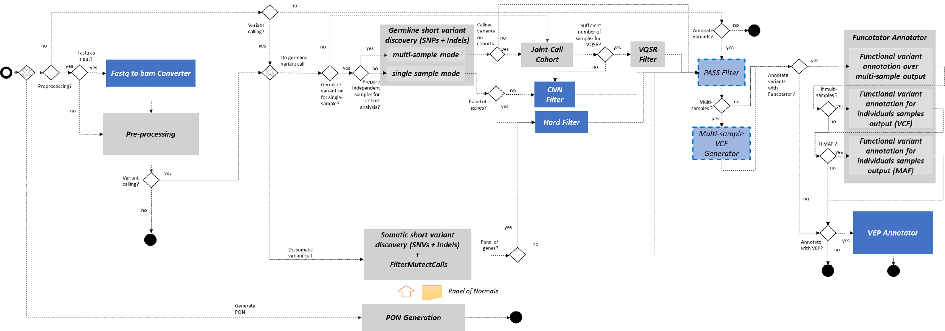
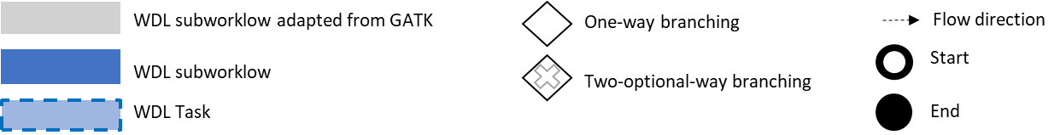
PIPEMB-WDL. Main implementation components and execution flow.
Legend:
WDL sub-workflow adapted from GATK
WDL sub-workflows

Slide 24
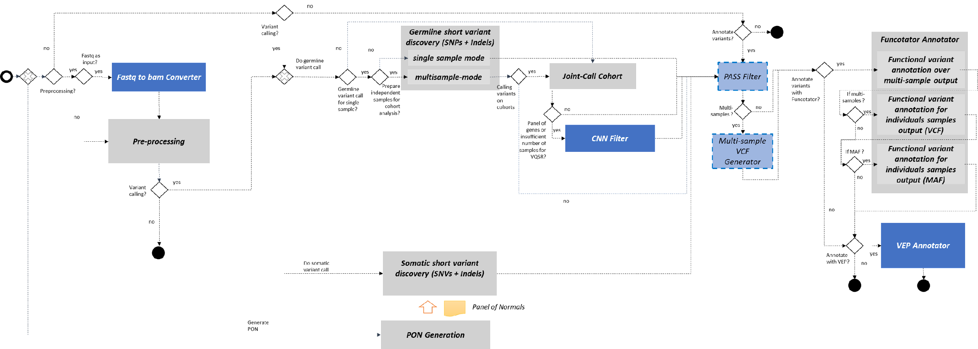
PIPEMB-WDL. Main implementation components and execution flow.
Legend:

Slide 25
PIPEMB workflow main conceptual model
Pre-processing
Variant discovery
Refinement and evaluation

Slide 26
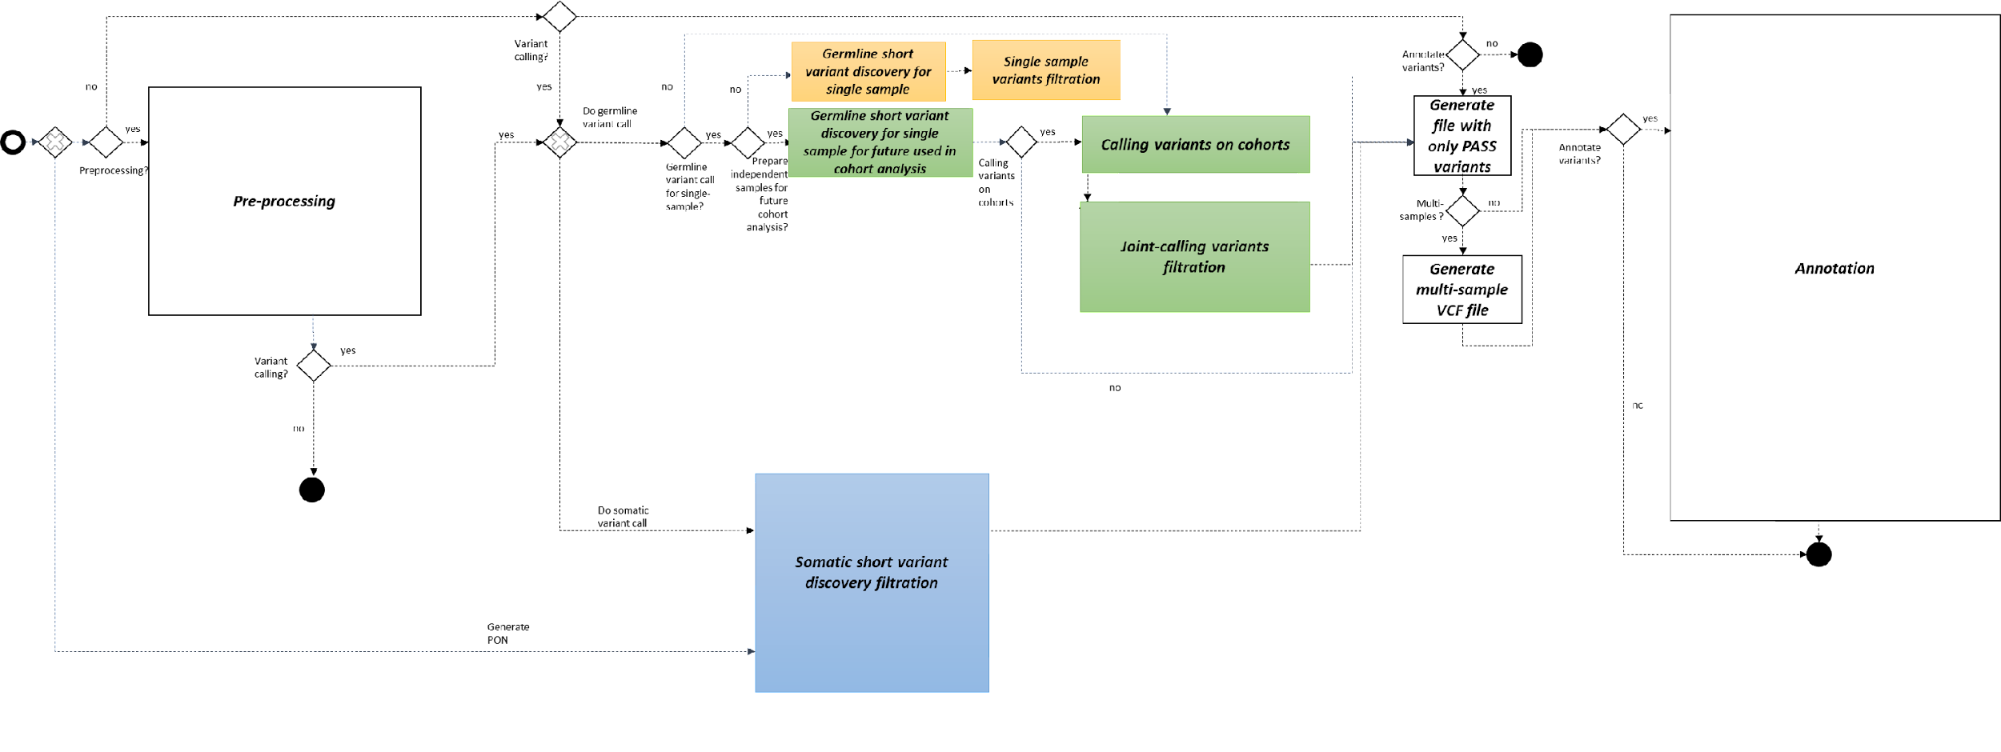
Workflow. Funcionalidades (nivel 1)

Slide 27
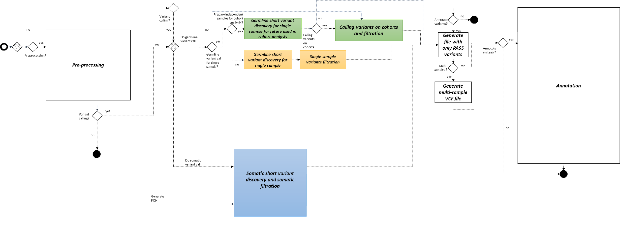
Workflow. Functionalities (level 1)

Slide 28
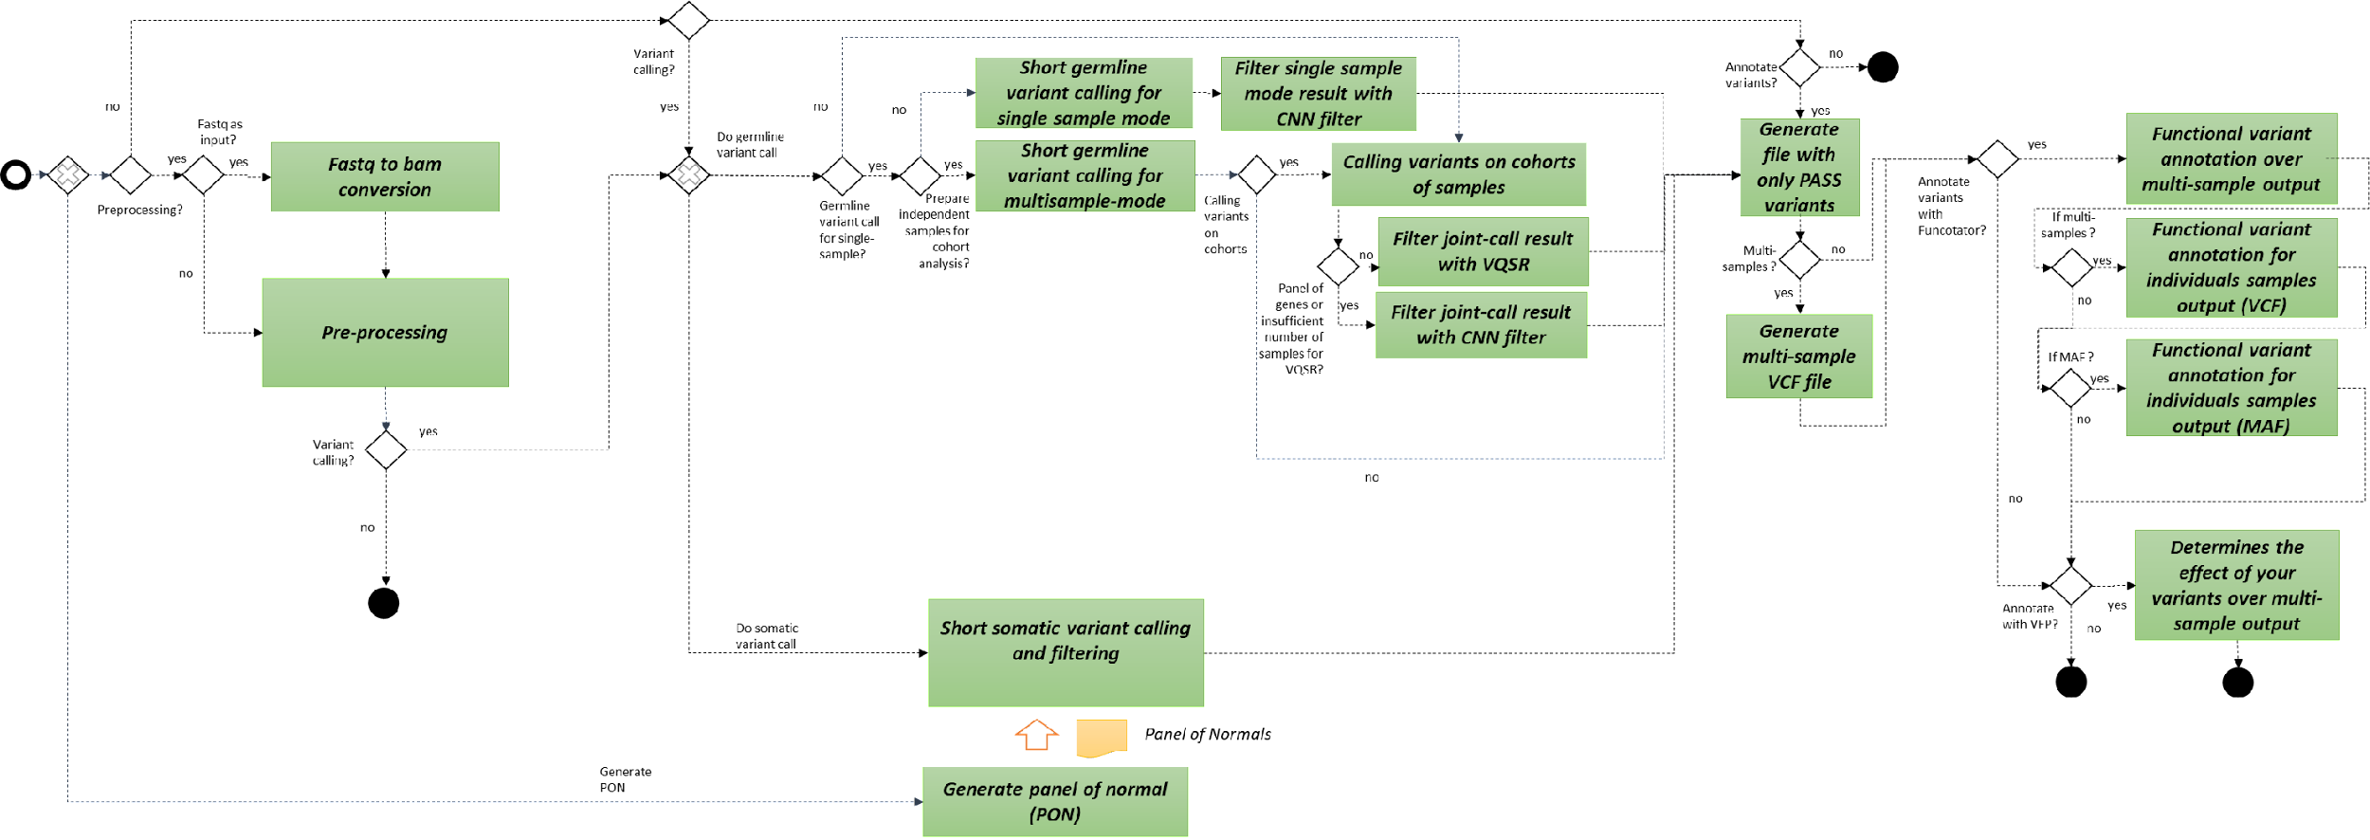
Workflow. Functionalities (level 2)

Slide 29
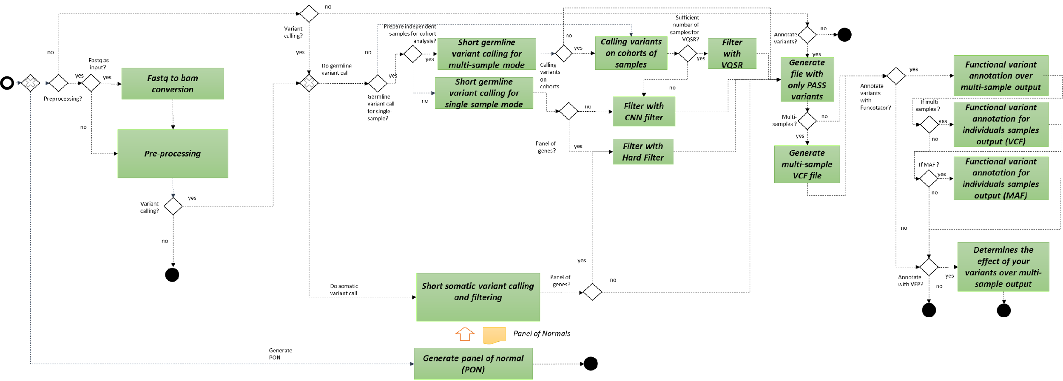
Workflow. Functionalities

Slide 30
Workflow. Functionalities
Pre-processing

Slide 31
Workflow. Functionalities
Pre-processing

Slide 32
Workflow. Functionalities
Variant discovery

Slide 33
Workflow. Functionalities
Variant discovery

Slide 34
Workflow. Functionalities
Refinement and evaluation

Slide 35
Workflow. Functionalities
Refinement and evaluation

Slide 36
Filtering
Processo | Tipo de estudo | Tipo de Sample | PIPE-MB v3 (script) | PIPE-MB v4 (Cromwell + Singularity + WDL)
Filter | Germline | Single sample | SelectVariant + VariantFiltration + CombineVariants | CNNScoreVariants + FilterVariantTranches
 |  | Multisample | VariantRecalibrator + ApplyRecalibration | VariantRecalibrator + ApplyRecalibration
 | Somatic | - | - | FilterMutectCalls
Hard filter script:
Variant Quality Score Recalibration (VQSR)
Tabela 1. Resumo das abordagems usadas para filtrar cada tipo de estudo .

Slide 37
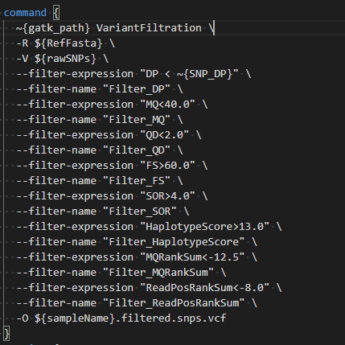
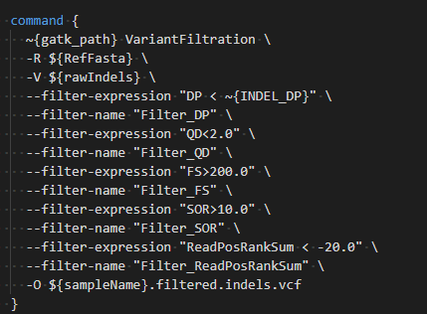
Hard Filtering Parameters
QualByDepth (QD)
FisherStrand (FS)
StrandOddsRatio (SOR)
RMSMappingQuality (MQ)
MappingQualityRankSumTest (MQRankSum)
ReadPosRankSumTest (ReadPosRankSum)
SNP_DP = 6
INDEL_DP = 32
hardFilterSNP
hardFilterIndel
Notes:
A saida sao ao menos que cumpla

Slide 38
Workflow. Functionalities

Slide 39
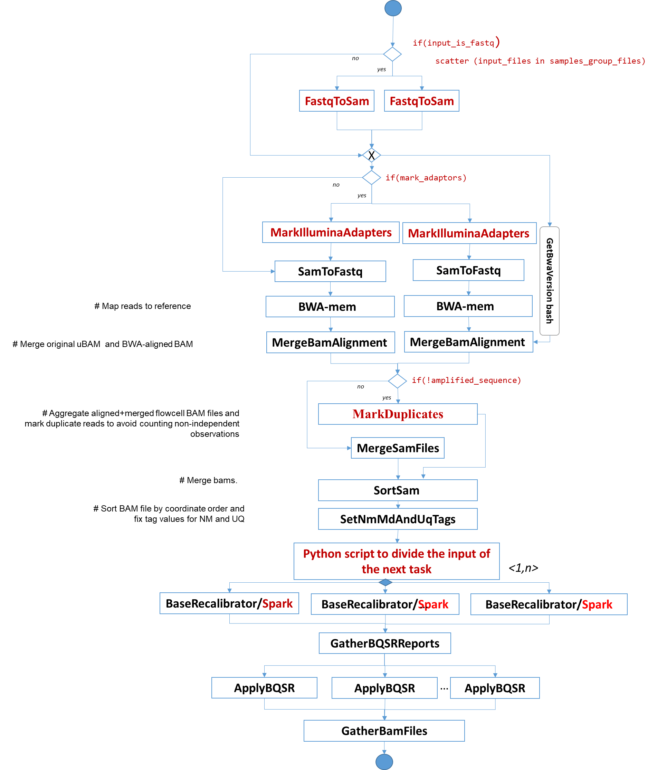
Pre-processing for multi-read single sample

Slide 40
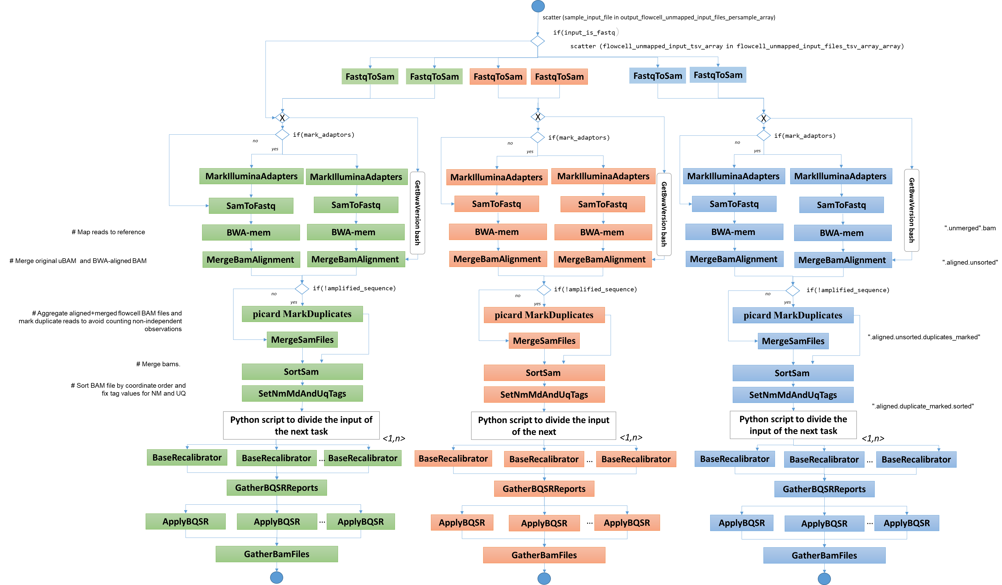
Pre-processing for multi-read multi-sample

Slide 41
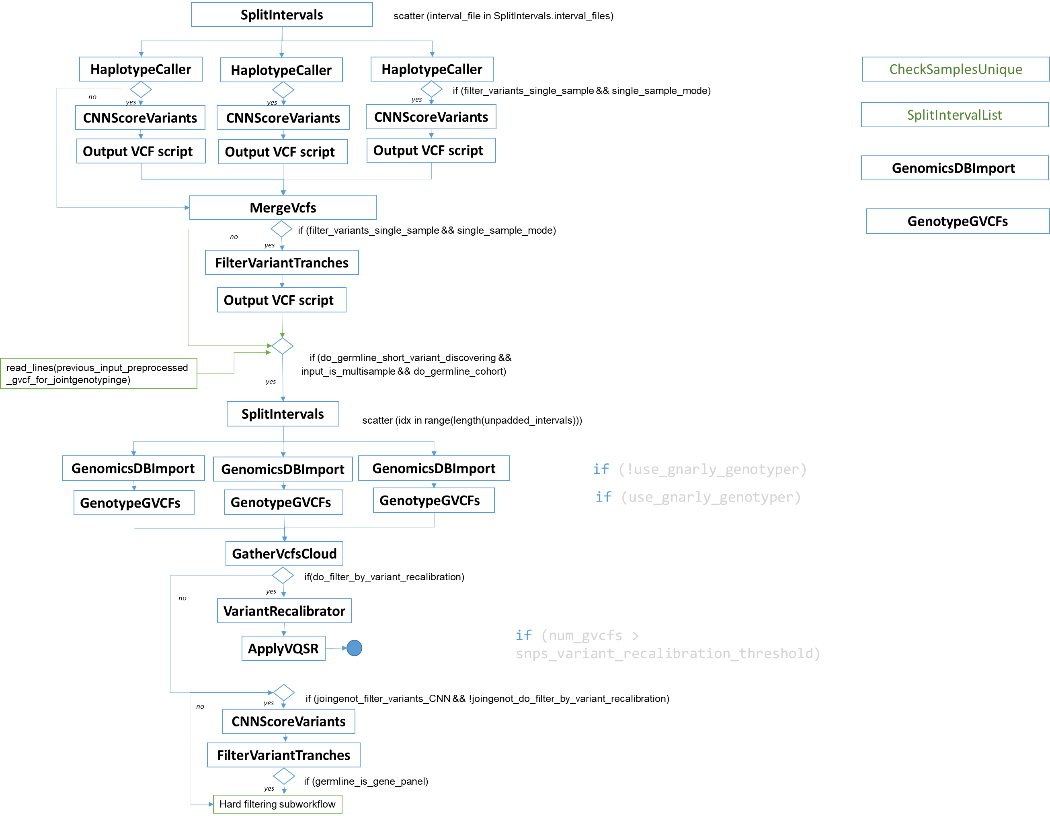
Germline variant calling and filtering

Slide 42
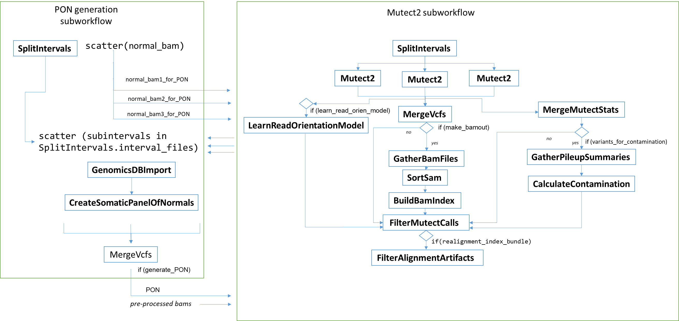

Slide 43
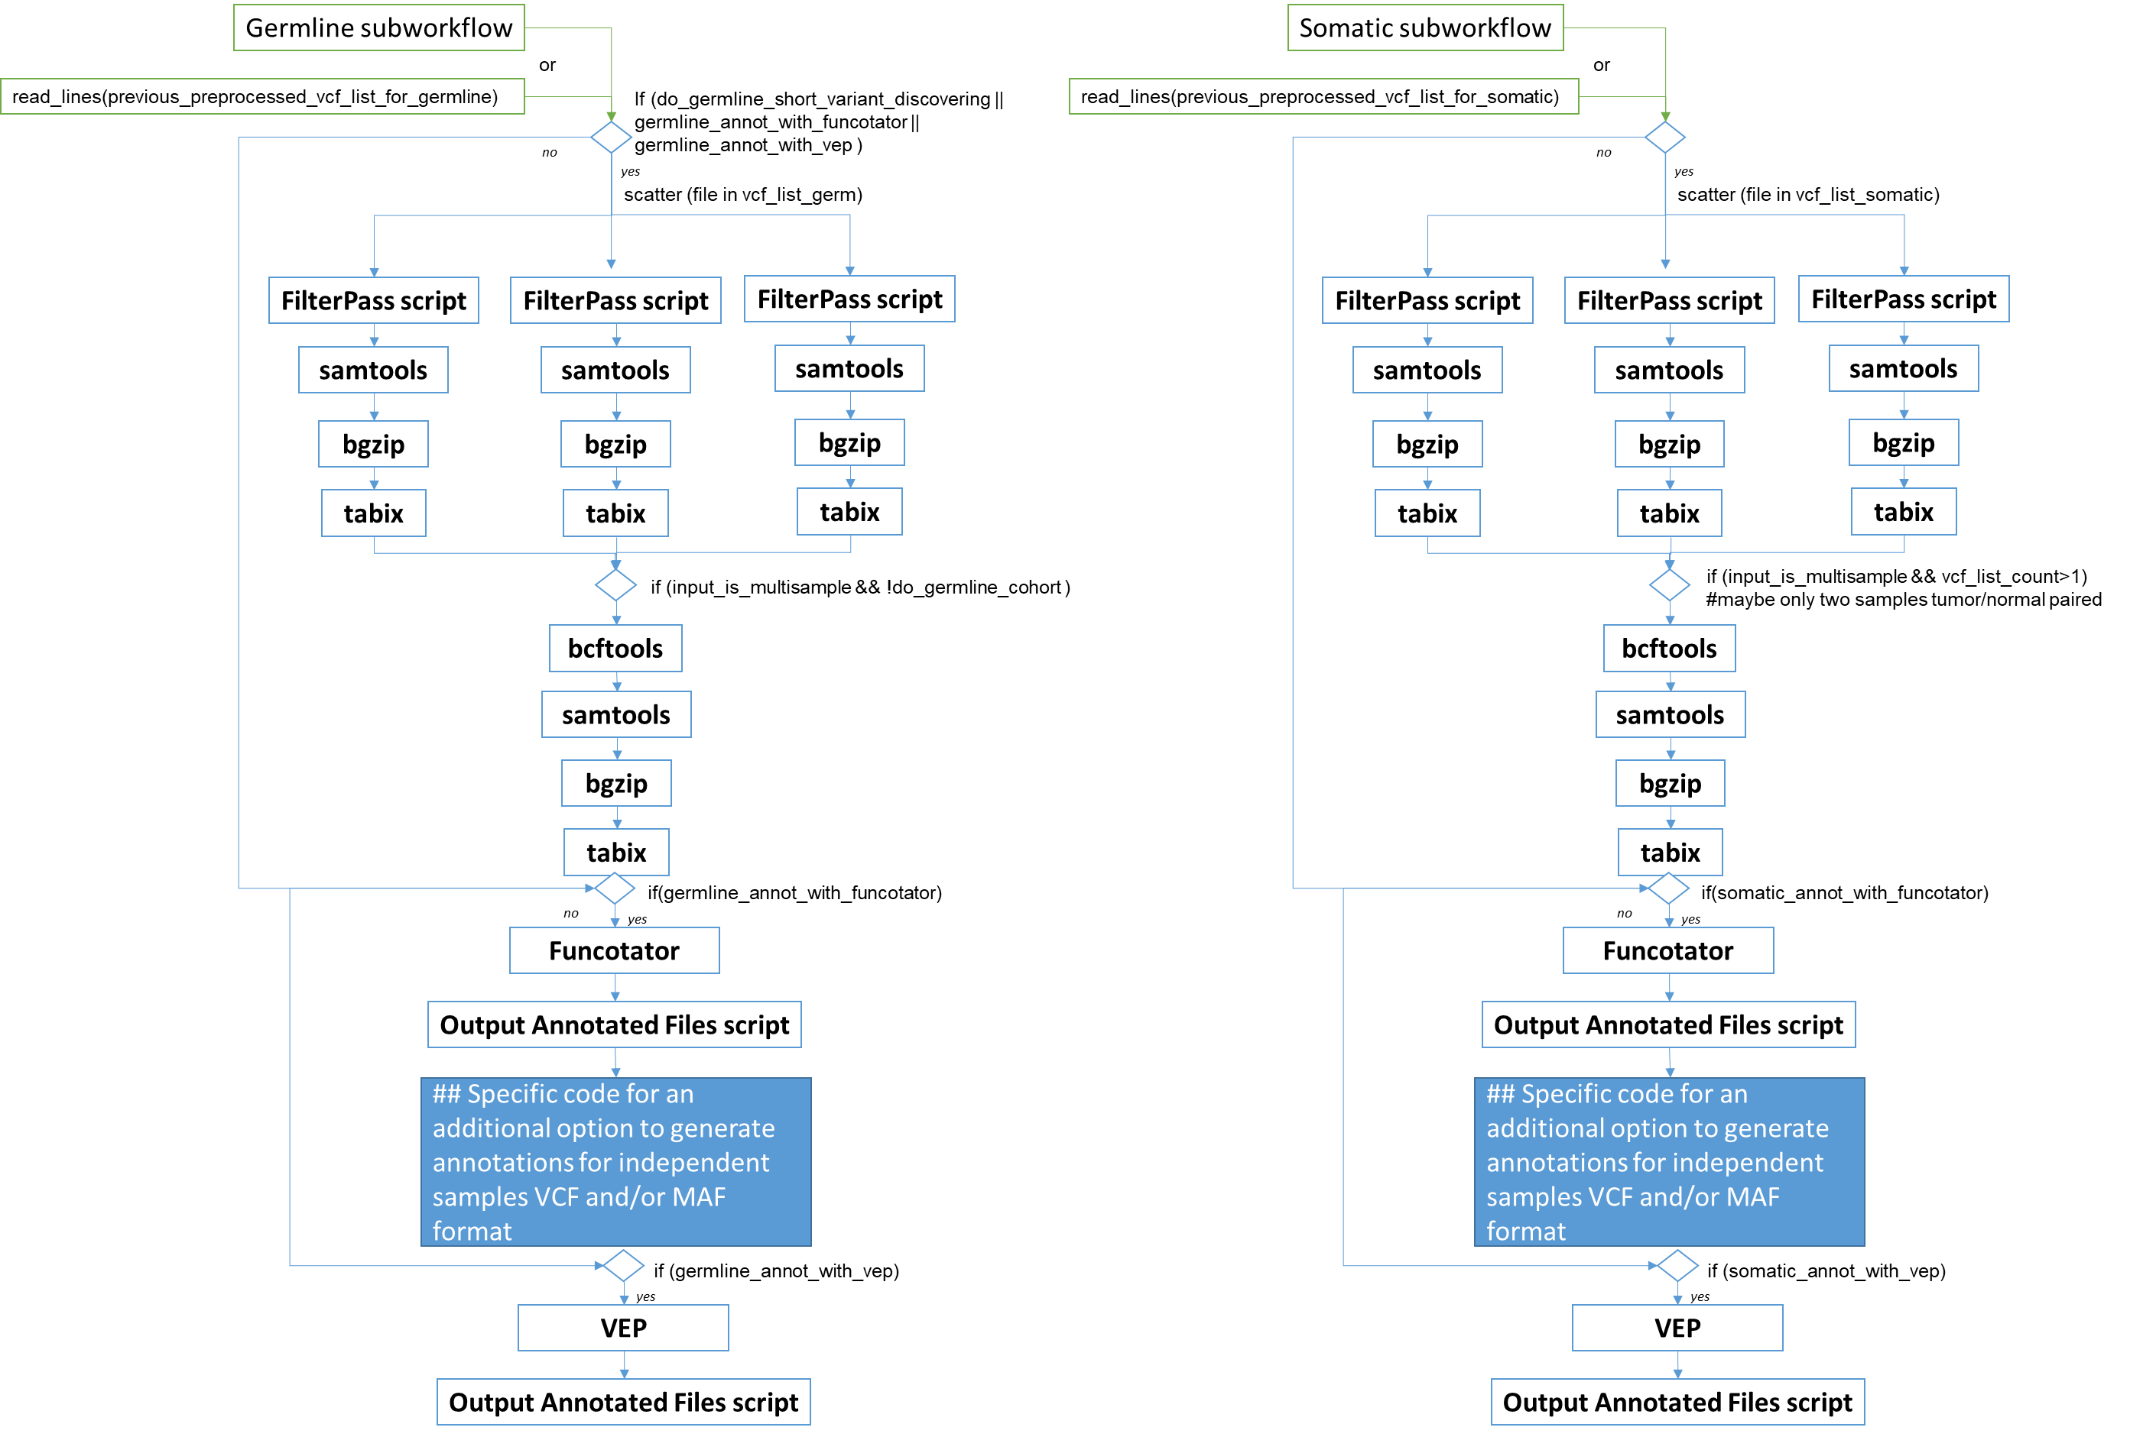

Slide 44
Tabela 2. Resumo das ferramentas usadas em cada etapa.

Slide 45
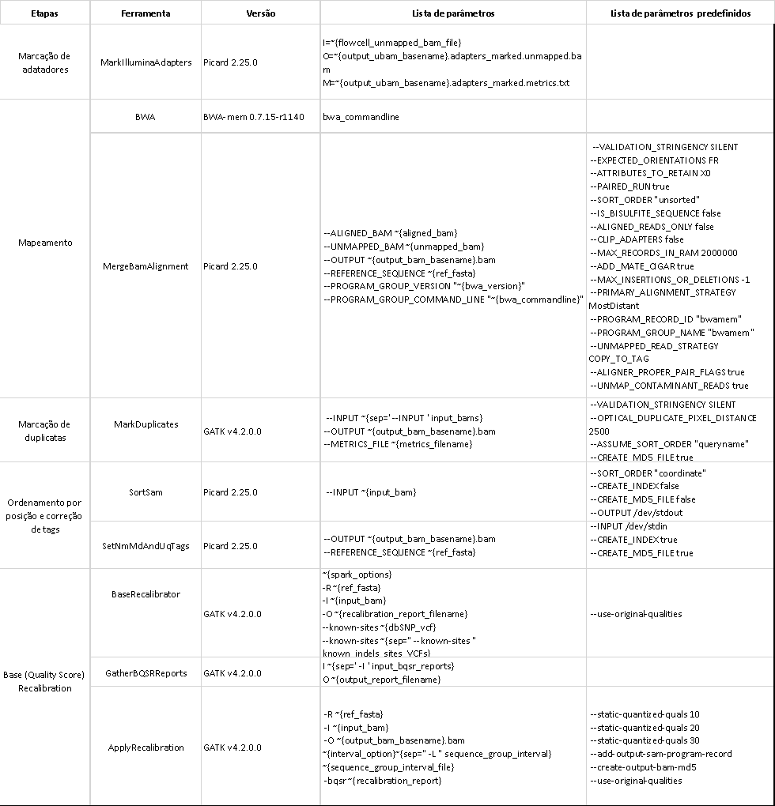
Tabela 3. Ferramentas usadas no pré-processamento com versões e parâmetros .

Slide 46
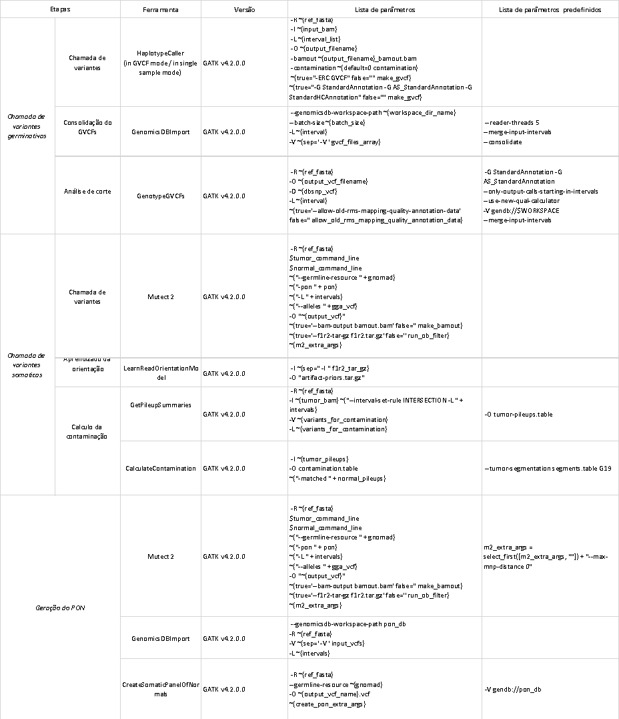
Tabela 4. Ferramentas usadas na chamada de variantes com versões e parâmetros.

Slide 47
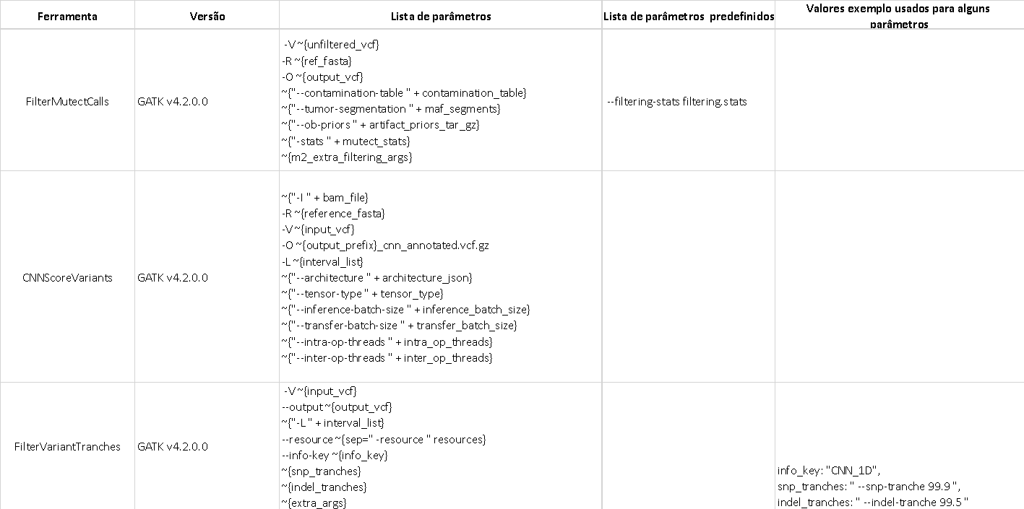
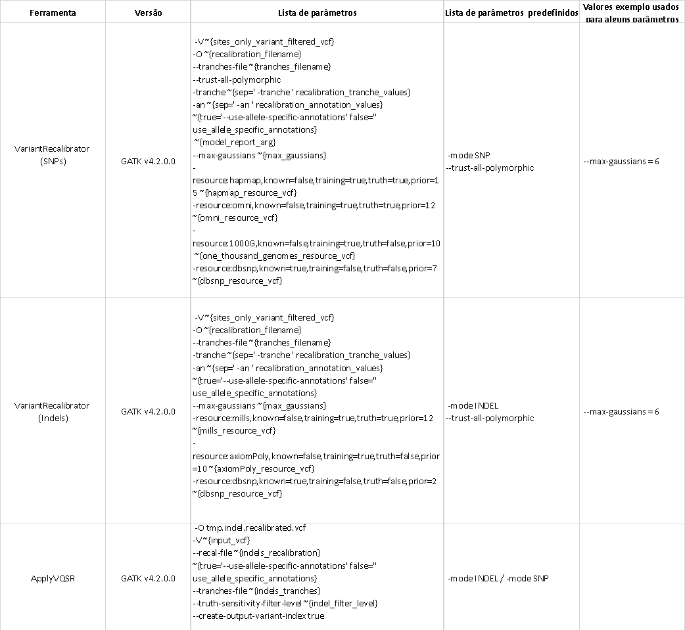
Tabela 5.1 Ferramentas usadas na filtragem (chamada de variantes germinativas em amostra simple e chamada de variantes somaticas) com versões e parâmetros.
Tabela 5.2 Ferramentas usadas na filtragem (VQSR) com versões e parâmetros.

Slide 48
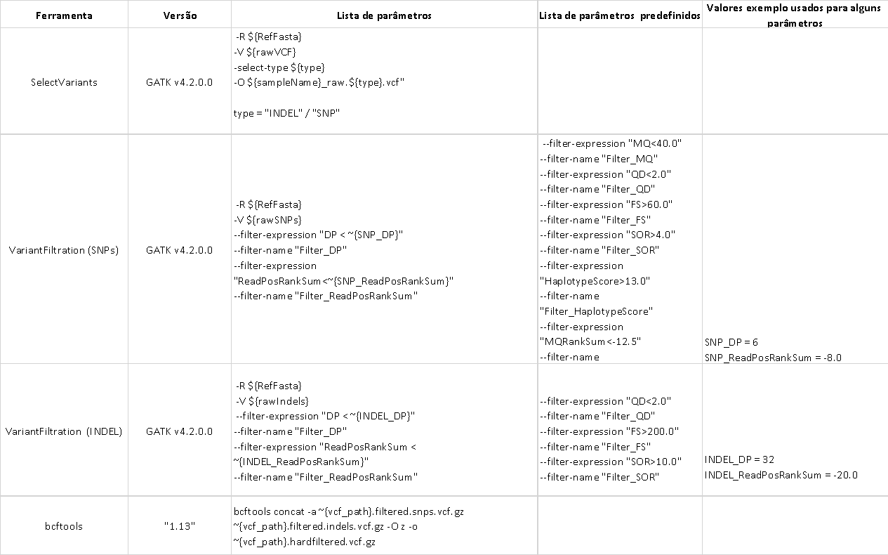
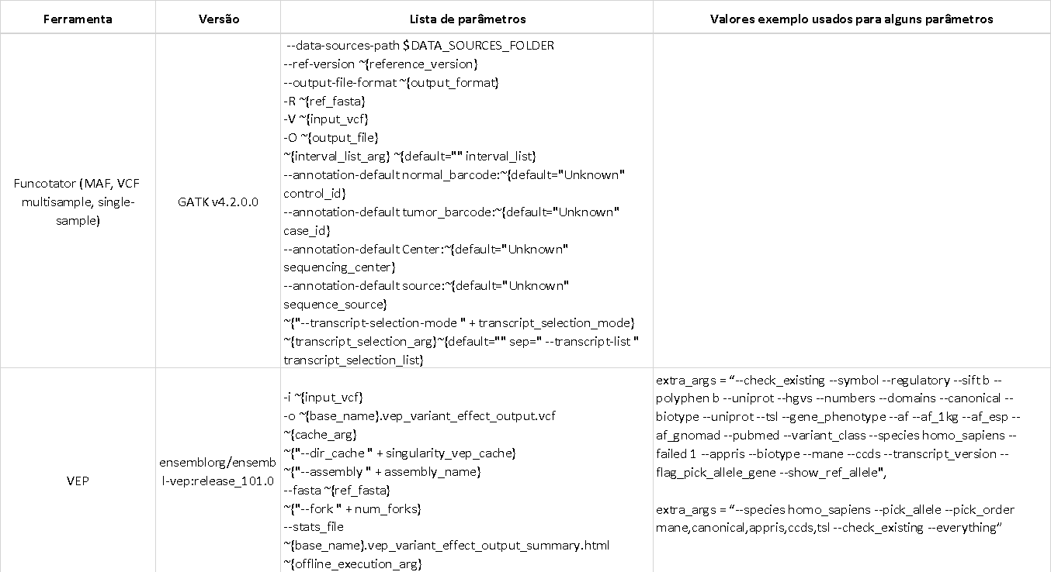
Tabela 5.3 Ferramentas usadas na filtragem (hard filtering) com versões e parâmetros.
Tabela 6. Ferramentas usadas na anotação com versões e parâmetros.

Slide 49
Challenges
WDL coding:
Lack of a language-specific IDE.
Language under development, with a mix of draft-1, draft-2 and draft-3 versions, and the current version 1.0. Incompatibility to integrate sub-workflows with different versions.
Periodic updates from Cromwell to run WDL.
Independent data directories between tasks (containers). The passage of input files for each task has to be with data type File.
Redundancy of files copied multiple times during a workflow run.
Existence of optional data types (use of "?", For example File and File?). The use of the select_first and select_all.
There is no “null” or “None” .
Impossibility to change the value of an attribute once set, the declaration of the variable is linked to the value assignment.
Conditionals without the option of the “else” block. Alternative use of select_first and select_all.
The type of output when using scatter when calling a task becomes Array.
Does not allow nested scatter.
Configuration and deployment: Slurm + Singularity + Cromwell
Support launching in Docker containers.
How to differentiate the infra for different tasks. Optional bindings.
Workload manager integration. Cromwell submitting jobs to Slurm.
How does Slurm know when a job has been completed?
Overcome the problem of Docker limit rate.

Slide 50
Summary
Motivation:
Variant calling workflow. PIPEMB
GATK: Best Practices, GATK and Picard, workflows
WDL + Cromwell
PIPEMB-WDL workflow. Construction process.
WDL coding
Installation
Infrastructure points
Execution:
Input sequence files
JSON file. Common options
Slurm script (command execution)
Execution time, output log (when you know that everything was successful)
Output directory

Slide 51
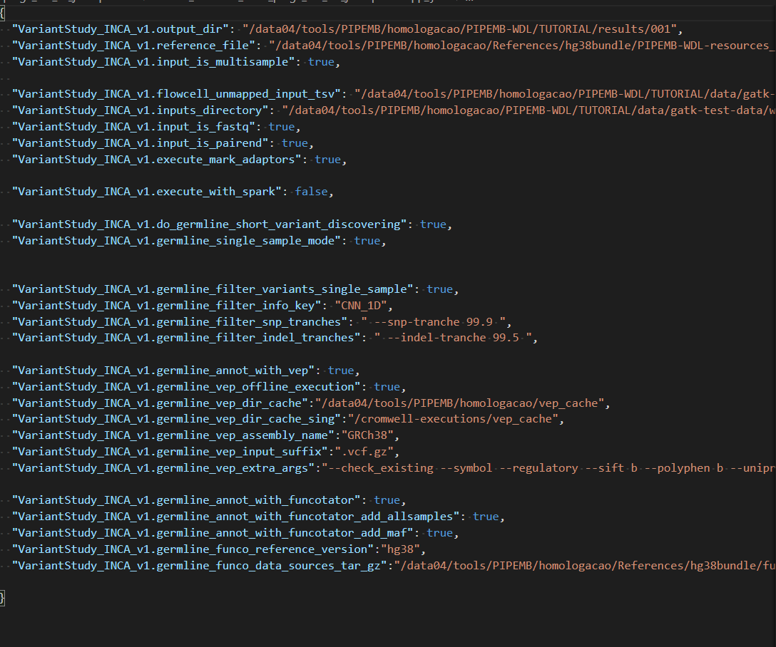
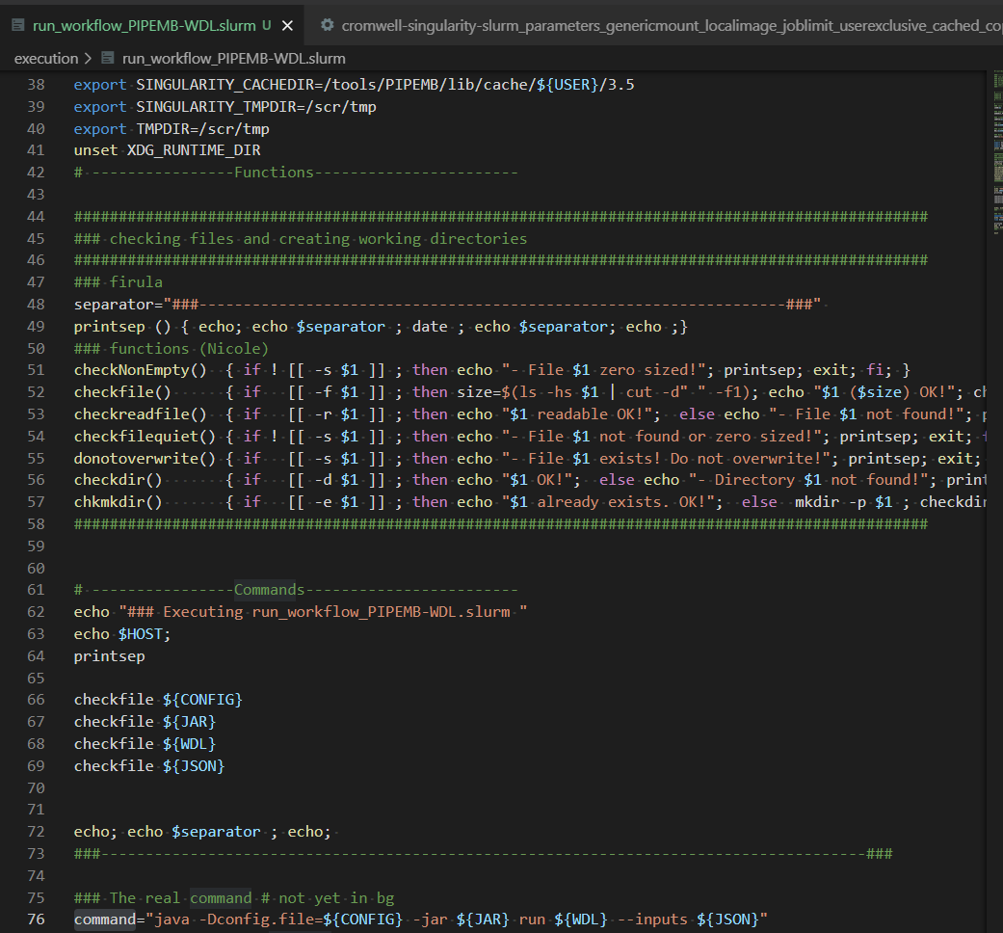
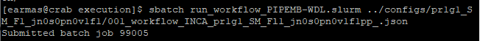
Execution
multisample_multipleRG_fastq.tsv
group1 /../data/a_R1.fastq /…/data/a_R2.fastq 1 SAMPLE1 ILLUMINA lib01 paired
group2 /../data/b_R1.fastq /../data/b_R2.fastq 2 SAMPLE1 ILLUMINA lib01 paired
group1 /../data/c_R1.fastq /../data/c_R2.fastq 3 SAMPLE2 ILLUMINA lib01 paired
group2 /../data/d_R1.fastq /../data/d_R2.fastq 4 SAMPLE2 ILLUMINA lib01 paired
JSON (parameters)
run_workflow_PIPEMB-WDL.slurm
https://github.com/BioBD/PIPEMB-WDL

Slide 52
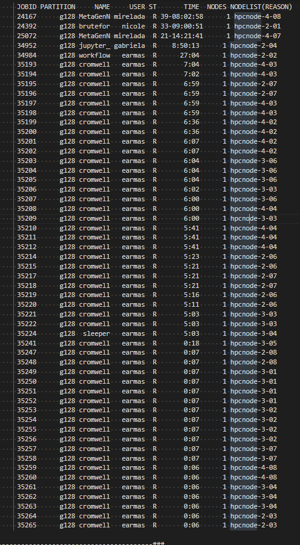
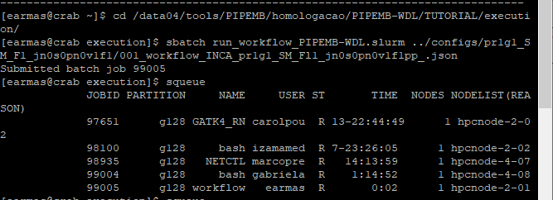
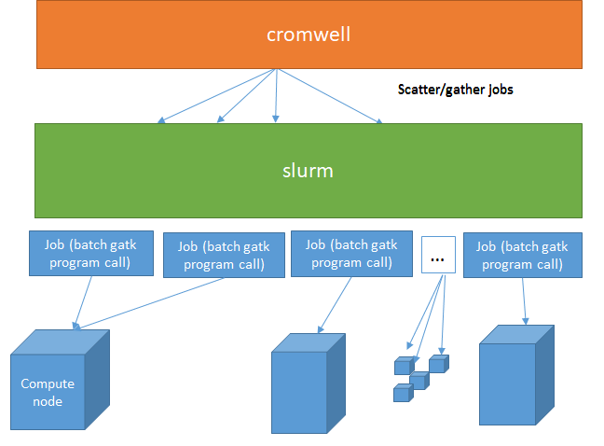
Execution

Slide 53
Common flows executed
/data04/tools/PIPEMB/homologacao/PIPEMB-WDL/TUTORIAL
Name convention for template configurations:
pr1g1_SM_Fl_jn0s0pn0f1v1:
0: disabled , 1: enabled
pr: pre-processing
g:germline
SM: single sample mode
MM: multisample mode
Fl: filtering
jn: joint genotyping
s:somatic
pn: create panel of normal
f: filter with Funcotator
v: filter with VEP
++/pp:filter with Funcotator with optional MAF and VCF for independent samples

Slide 54
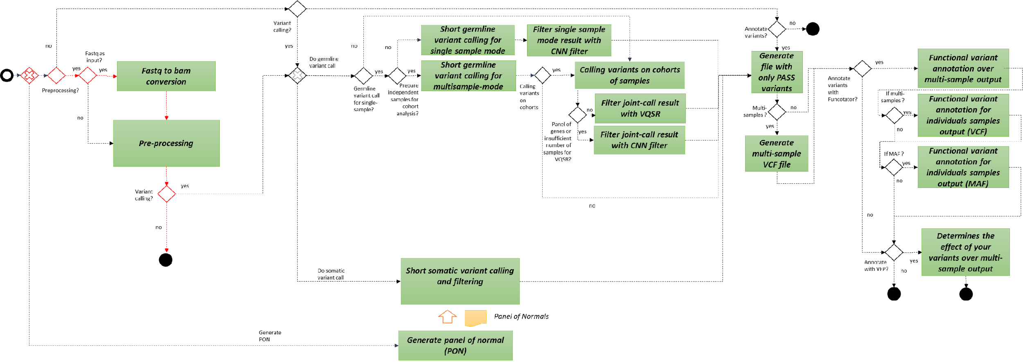
pr1g0jn0s0pn0f0v0

Slide 55
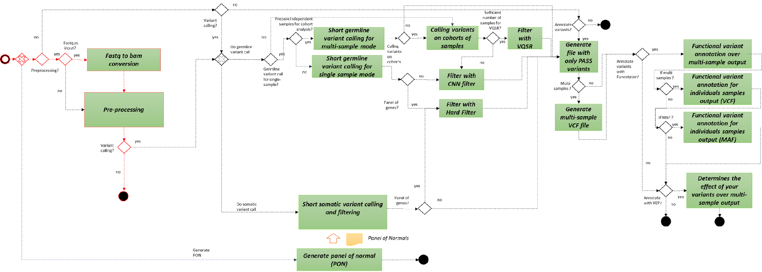
pr1g0jn0s0pn0f0v0

Slide 56

pr1g1_SM_Fl_jn0s0pn0f1v1

Slide 57
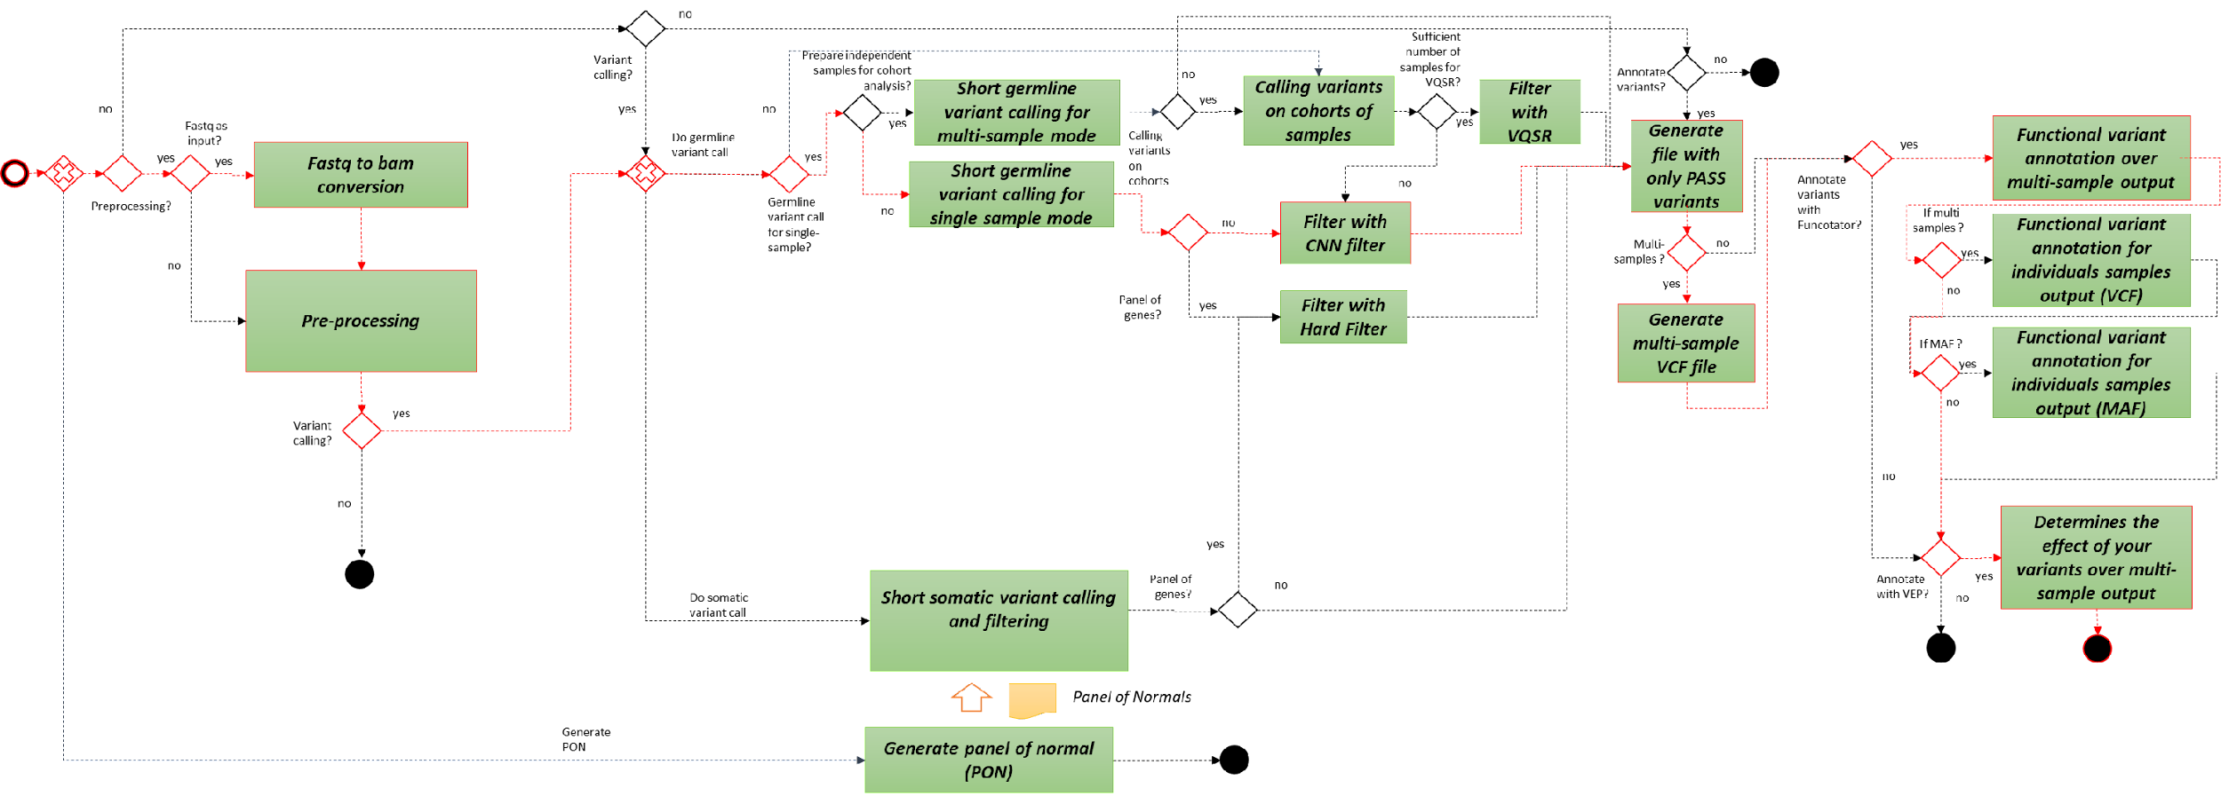
pr1g1_SM_Fl_jn0s0pn0f1v1

Slide 58

pr0g0jn0s1f1v1

Slide 59
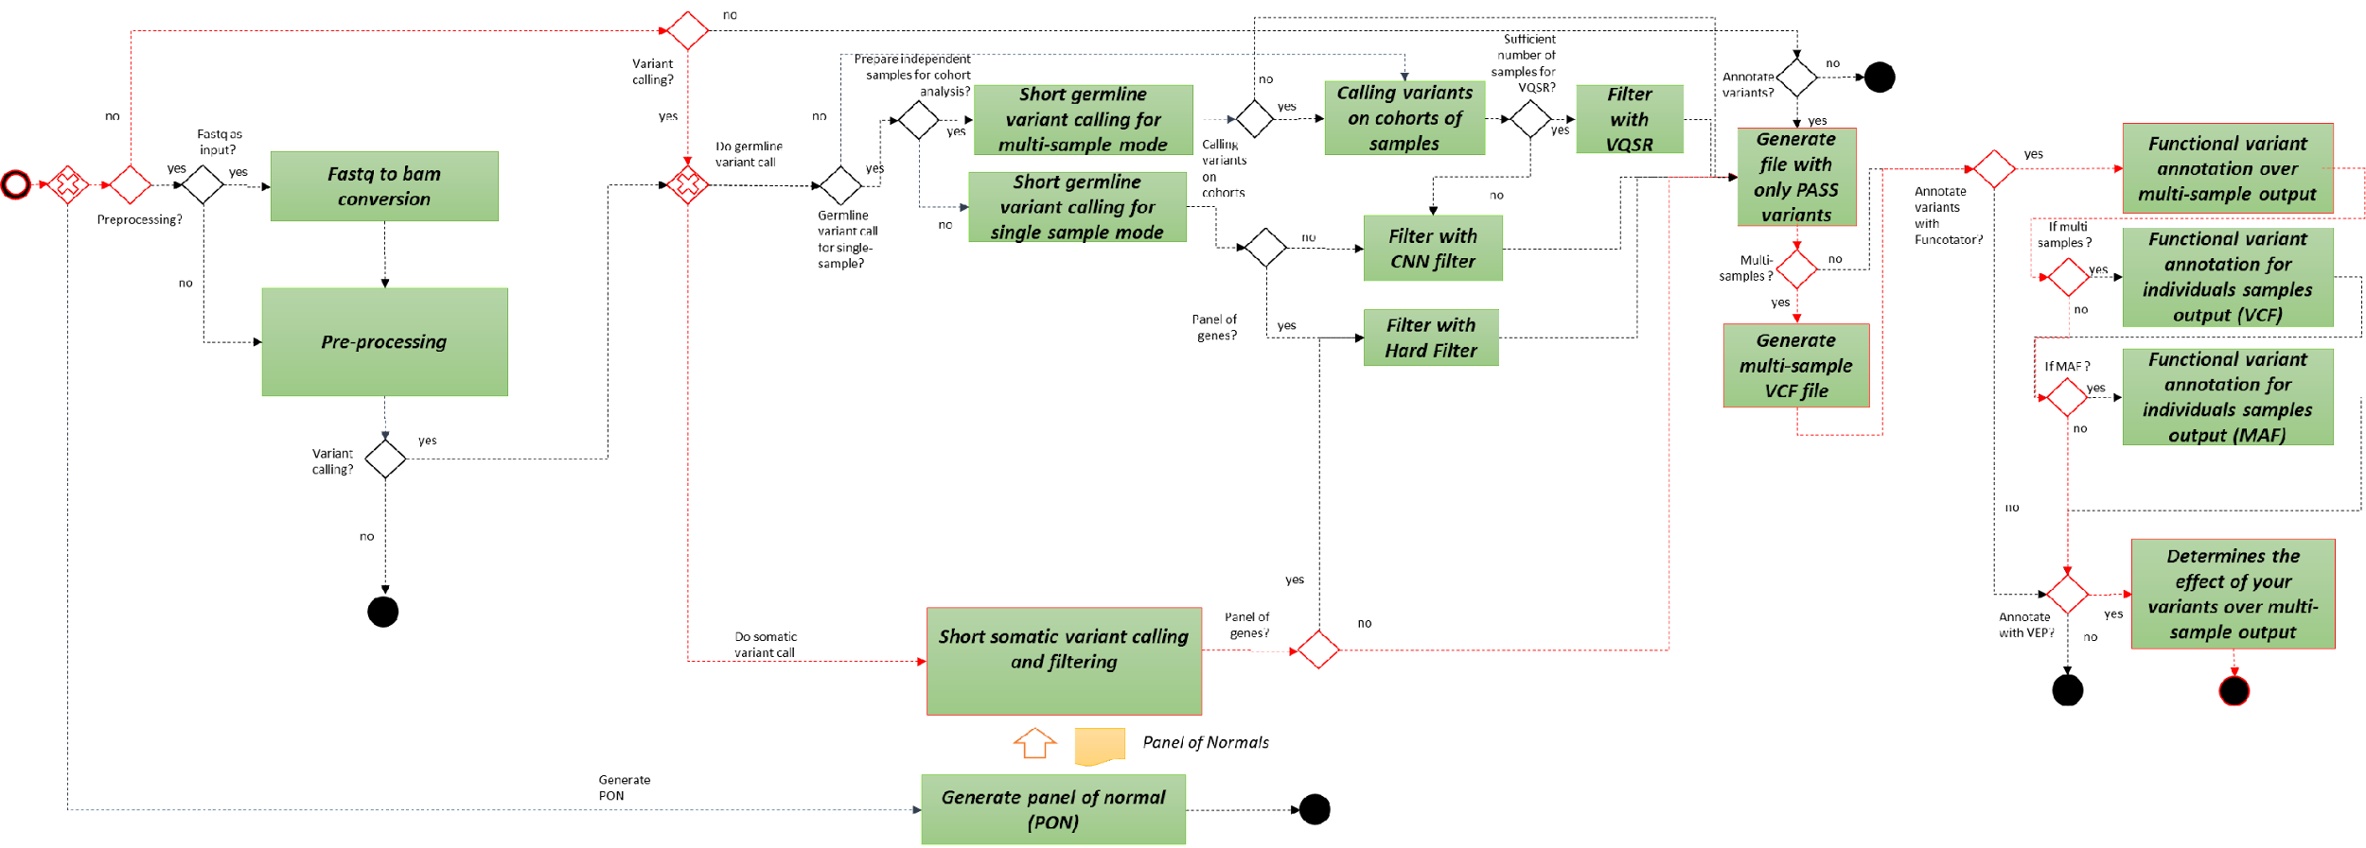
pr0g0jn0s1f1v1

Slide 60
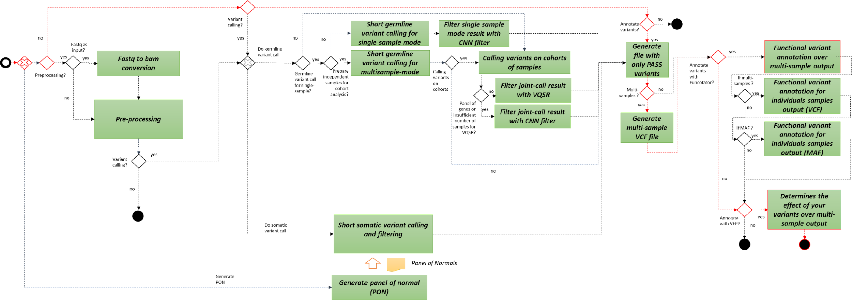
pr0g0jn0s0pn0f0v1

Slide 61

pr0g0jn0s0pn0f1v1

Slide 62
Execution
Tutorial:
Part 1. Presenting the structure of directories and JSON files.
Part 2. Executing.
Part 3. Executing process. Output directory
Part 4. Output directory.

Slide 63
PIPEMB, an integrated workflow for a short genomic variant discovery
LBBC – INCA
Rio de Janeiro
2022
Elvismary Molina de Armas (Ema) Prof. Sérgio Lifschitz
PUC-RIO
Mariana Boroni
Nicole Scherer
INCA

Slide 64
PIPEMB-WDL FILTERS

Slide 65
Processo | Tipo de estudo | Tipo de Sample | PIPE-MB v3 (script) | PIPE-MB v4 (Cromwell + Singularity + WDL)
Filter | Germline | Single sample | SelectVariant + VariantFiltration + CombineVariants | CNNScoreVariants + FIlterVariantTranches
 |  | Multisample | VariantRecalibrator + ApplyRecalibration | VariantRecalibrator + ApplyRecalibration
 | Somatic | - | - | FilterMutectCalls
Hard filter script:
Variant Quality Score Recalibration (VQSR)

Slide 66
Hard filtering vs VQSR
Hard-filtering:
Consists of choosing specific thresholds for one or more annotations and throwing out any variants that have annotation values above or below the set thresholds.
Annotations: properties or statistics that describe for each variant e.g. what the sequence context is like around the variant site, how many reads covered it, how many reads covered each allele, what proportion of reads were in forward vs reverse orientation, and so on.
The problem with this approach is that it is very limiting because it forces you to look at each annotation dimension individually, and you end up throwing out good variants just because one of their annotations looks bad, or keeping bad variants in order to keep those good variants.
VQSR:
More powerful because it uses machine-learning algorithms to learn from the data what are the annotation profiles of good variants (true positives) and of bad variants (false positives) in a particular dataset. This empowers you to pull out variants based on how they cluster together along different dimensions, and liberates you to a large extent from the linear tyranny of single-dimension thresholds.
Unfortunately this method requires a large number of variants and well-curated known variant resources. For those of you working with small gene panels or with non-model organisms, this is a deal-breaker, and you have to fall back on hard-filtering.
https://gatk.broadinstitute.org/hc/en-us/articles/360035890471-Hard-filtering-germline-short-variants (06/2021 updated)
This document aims to provide some insight into the logic of the generic hard-filtering recommendations that we provide as a substitute for VQSR (the method we normally recommend for filtering germline short variants).
Notes:
algoritmos de aprendizaje automático para aprender de los datos cuáles son los perfiles de anotación de las variantes buenas (verdaderos positivos) y de las malas variantes (falsos positivos) en un conjunto de datos en particular

Slide 67
Links relacionados
https://gatk.broadinstitute.org/hc/en-us/articles/360035890471-Hard-filtering-germline-short-variants (06/2021 updated)
https://gatk.broadinstitute.org/hc/en-us/articles/360035531112--How-to-Filter-variants-either-with-VQSR-or-by-hard-filtering
https://gatk.broadinstitute.org/hc/en-us/articles/360035531612-Variant-Quality-Score-Recalibration-VQSR-

Slide 68
Hard filtering vs VQSR
Hard filtering is applied by filtering via thresholds for metrics such as QualByDepth, FisherStrand, RMSMappingQuality, MappingQualityRankSumTest, ReadPosRankSumTest, and StrandOddsRatio.
VQSR, on the other hand, relies on machine learning to identify annotation profiles of variants that are likely to be real. It requires a large training dataset (minimum 30 WES data, at least one WGS data if possible) and well-curated sets of known variants. The aim is to assign a well-calibrated probability to each variant call to create accurate variant quality scores that are then used for filtering.
The accuracy of variant calling is also affected by coverage. Coverage can be broadly defined as the number of unique reads that include a given nucleotide. Coverage is affected by the accuracy of alignment algorithms and by the “mappability” of reads. Coverage can be utilized for both the filtration of variants and for a general evaluation of the sequencing experiment.
https://www.intechopen.com/books/bioinformatics-tools-for-detection-and-clinical-interpretation-of-genomic-variations/bioinformatics-workflows-for-genomic-variant-discovery-interpretation-and-prioritization

Slide 69
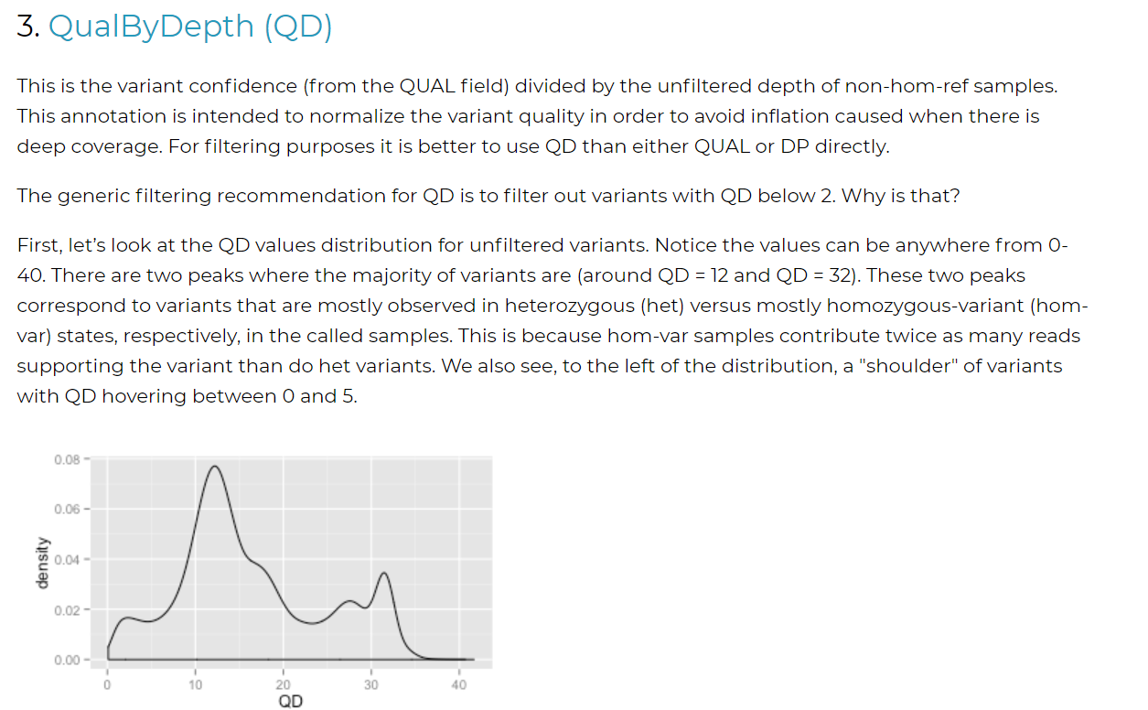
https://gatk.broadinstitute.org/hc/en-us/articles/360035890471-Hard-filtering-germline-short-variants
Notes:
https://gatk.broadinstitute.org/hc/en-us/articles/360035890471-Hard-filtering-germline-short-variants

Slide 70
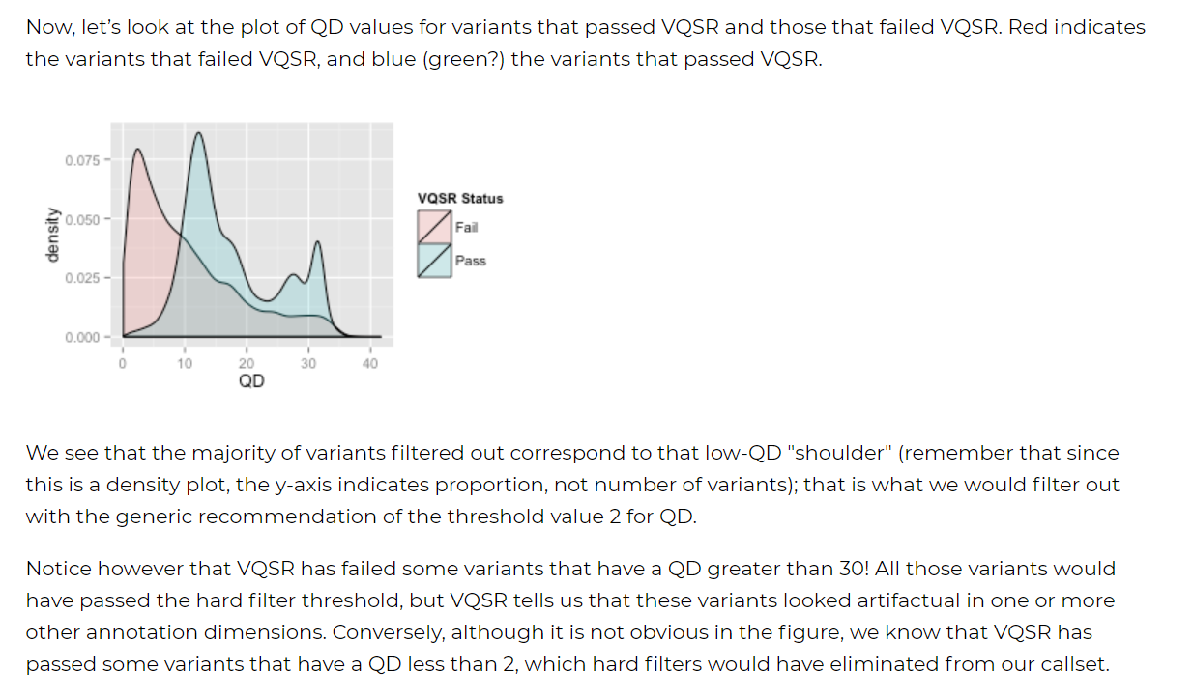

Slide 71
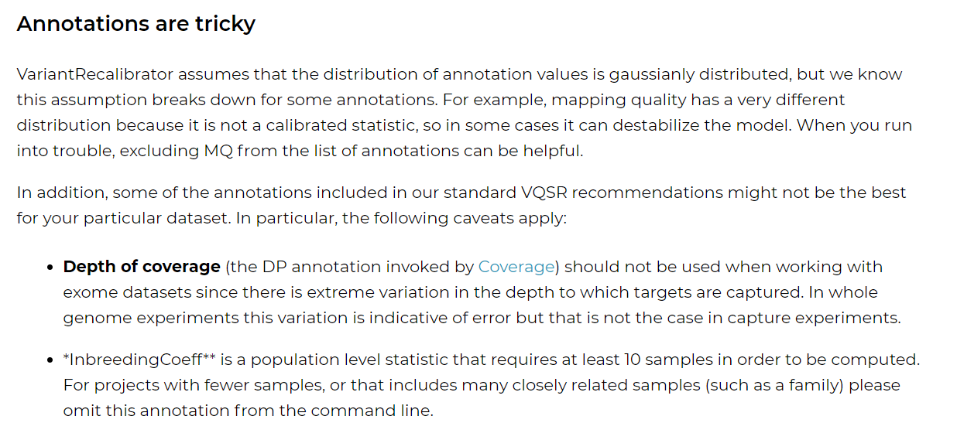
Variant-Quality-Score-Recalibration-VQSR-
https://gatk.broadinstitute.org/hc/en-us/articles/360035531612-Variant-Quality-Score-Recalibration-VQSR-

Slide 72
CNNScoreVariants
https://gatk.broadinstitute.org/hc/en-us/community/posts/360073082912-What-is-the-correct-step-VQSR-and-CNNScoreVariants-
VQSR:
https://core.ac.uk/download/pdf/323064116.pdf
https://gatk.broadinstitute.org/hc/en-us/articles/360035890551-Allele-specific-annotation-and-filtering-of-germline-short-variants

Slide 73
Texto do Relatorio/2021
No caso das variantes germinativas, para análises de amostras independentes, na versão GATK 4 é recomendado o uso de ferramentas baseadas em Inteligência Artificial, CNNScoreVariants(GATK-Team 2022b) e FilterVariantTranches (GATK-Team 2022d).
A primeira ferramenta, CNNScoreVariants, usa um modelo computacional pré-treinado (no caso uma Rede Neural Convolucional – CNN), para dar pontuações a cada variante num arquivo VCF. Já o FilterVariantTranches, recebe como parâmetros a faixa das pontuações permissíveis e acessa a alguns recursos que usa como guia para filtrar as variantes.
A anotação consiste num valor numérico no campo INFO de um VCF. “As faixas são especificadas em porcentagem de sensibilidade às variantes nos arquivos de recursos. Por exemplo, se você especificar faixas INDEL 98.0 e 99.0 usando a pontuação de tipo CNN_1D, o VCF filtrado conterá 2 faixas de filtro para INDELS: CNN_1D_INDEL_Tranche_98.00_99.00 e CNN_1D_INDEL_Tranche_99.00_100.00. As variantes que pontuaram melhor que o percentil 98 de variantes nos recursos passam pelo filtro e terão 'PASS' no campo de filtro. Esperamos que as variantes na parcela CNN_2D_INDEL_Tranche_99.00_100.00 sejam mais sensíveis, mas menos precisas do que CNN_2D_INDEL_Tranche_98.00_99.00, porque as variantes em CNN_2D_INDEL_Tranche_99.00_100.00 têm pontuações mais baixas do que as variantes na parcela CNN_2D_INDEL_Tranche_98.00_99.00. O limite de filtragem das faixas padrão para SNPs é 99,95 e para INDELs é 99,4. Esses limites maximizam a pontuação F1 (a média harmônica de sensibilidade e precisão) para dados humanos de genoma inteiro, mas podem precisar ser ajustados para diferentes conjuntos de dados”. (GATK-Team 2022d)

Slide 74
Issues (Estudo Nano (Carol))
shard-2
19:10:15.017 INFO FilterVariantTranches - Found 18 SNPs and 7 indels with INFO score key:CNN_1D.
19:10:15.017 INFO FilterVariantTranches - Found 14 SNPs and 0 indels in the resources.
19:10:15.017 INFO FilterVariantTranches - Filtered 0 SNPs out of 18 and filtered 0 indels out of 7 with INFO score: CNN_1D.
19:10:15.023 INFO FilterVariantTranches - Shutting down engine
[September 2, 2021 7:10:15 PM GMT] org.broadinstitute.hellbender.tools.walkers.vqsr.FilterVariantTranches done. Elapsed time: 0.02 minutes.
Runtime.totalMemory()=2053111808
***********************************************************************
A USER ERROR has occurred: Bad input: Indels are present in input VCF, but cannot be filtered because no overlapping indels were found in the resources.

Slide 75
Germline
Single sample variant discovery uses HaplotypeCaller in its default single-sample mode to call variants in an analysis-ready BAM file. The VCF that HaplotypeCaller emits errs on the side of sensitivity, so some filtering is often desired. To filter variants first run the CNNScoreVariants tool. This tool annotates each variant with a score indicating the model's prediction of the quality of each variant. To apply filters based on those scores run the FIlterVariantTranches tool with SNP and INDEL sensitivity tranches appropriate for your task.
https://github.com/broadinstitute/gatk/tree/master/scripts
https://github.com/broadinstitute/gatk/tree/master/scripts/cnn_variant_wdl
https://github.com/broadinstitute/gatk/tree/master/scripts/cnn_variant_cromwell_tests

Slide 76
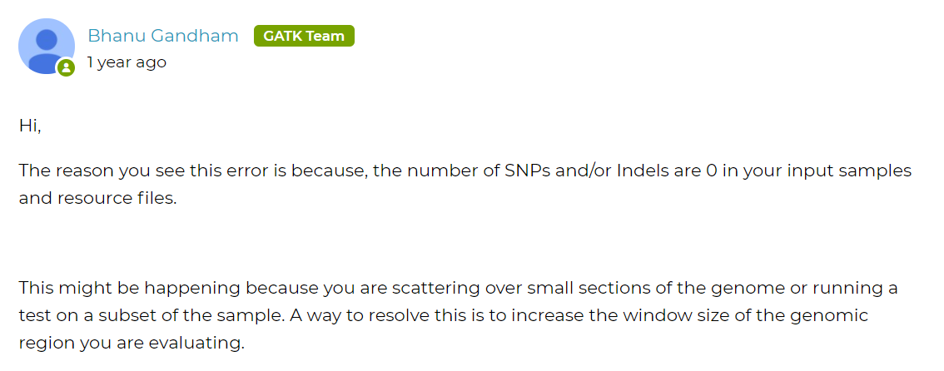
https://gatk.broadinstitute.org/hc/en-us/community/posts/360056456092-FilterVariantTranches-User-error

Slide 77
Proposta para FilterVariantTranches :
Avaliar resources:
FilterVariantTranches \
-V /cromwell-executions/VariantStudy_INCA_v1/e45744e1-ae8d-4f3c-9e7e-5f2c5ff53882/call-HaplotypeCallerGvcf_GATK4/shard-39/HaplotypeCallerGvcf_GATK4/c4dcddfa-c364-4d66-a69e-51a531d682ee/call-FilterVariantTranches/inputs/2033626005/S-50.hg38.vcf.gz \
--output S-50.hg38_cnn_filtered.vcf.gz \
--resource /cromwell-executions/VariantStudy_INCA_v1/e45744e1-ae8d-4f3c-9e7e-5f2c5ff53882/call-HaplotypeCallerGvcf_GATK4/shard-39/HaplotypeCallerGvcf_GATK4/c4dcddfa-c364-4d66-a69e-51a531d682ee/call-FilterVariantTranches/inputs/497750659/hapmap_3.3.hg38.vcf.gz -resource /cromwell-executions/VariantStudy_INCA_v1/e45744e1-ae8d-4f3c-9e7e-5f2c5ff53882/call-HaplotypeCallerGvcf_GATK4/shard-39/HaplotypeCallerGvcf_GATK4/c4dcddfa-c364-4d66-a69e-51a531d682ee/call-FilterVariantTranches/inputs/497750659/1000G_phase1.snps.high_confidence.hg38.vcf.gz -resource /cromwell-executions/VariantStudy_INCA_v1/e45744e1-ae8d-4f3c-9e7e-5f2c5ff53882/call-HaplotypeCallerGvcf_GATK4/shard-39/HaplotypeCallerGvcf_GATK4/c4dcddfa-c364-4d66-a69e-51a531d682ee/call-FilterVariantTranches/inputs/497750659/Mills_and_1000G_gold_standard.indels.hg38.vcf.gz \
--info-key CNN_1D \
--snp-tranche 99.9 \
--indel-tranche 99.5 \`
Control de erros. Que passa com a tarefa FilterPass, criaria arquivos com header, info, mas com ninhuma linha variante:
continueOnReturnCode (https://cromwell.readthedocs.io/en/stable/RuntimeAttributes/#continueonreturncode)

Slide 78
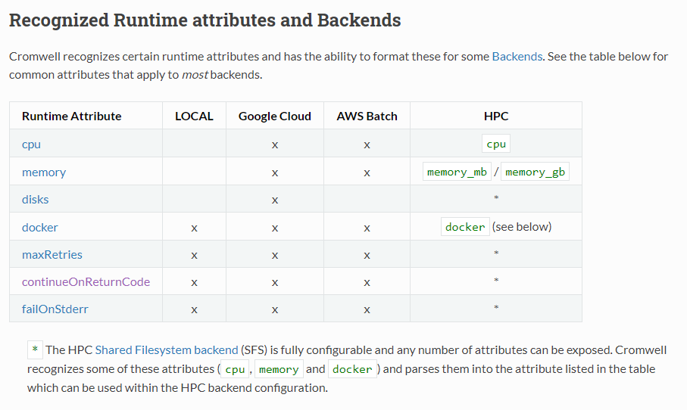
FilterVariantTranches. Gerenciamento do erro.
https://cromwell.readthedocs.io/en/stable/RuntimeAttributes/#continueonreturncode

Slide 79
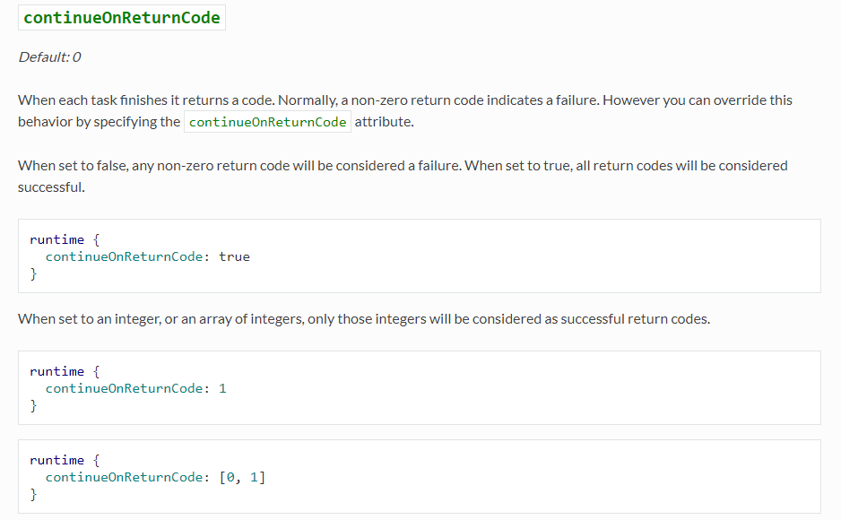

Slide 80
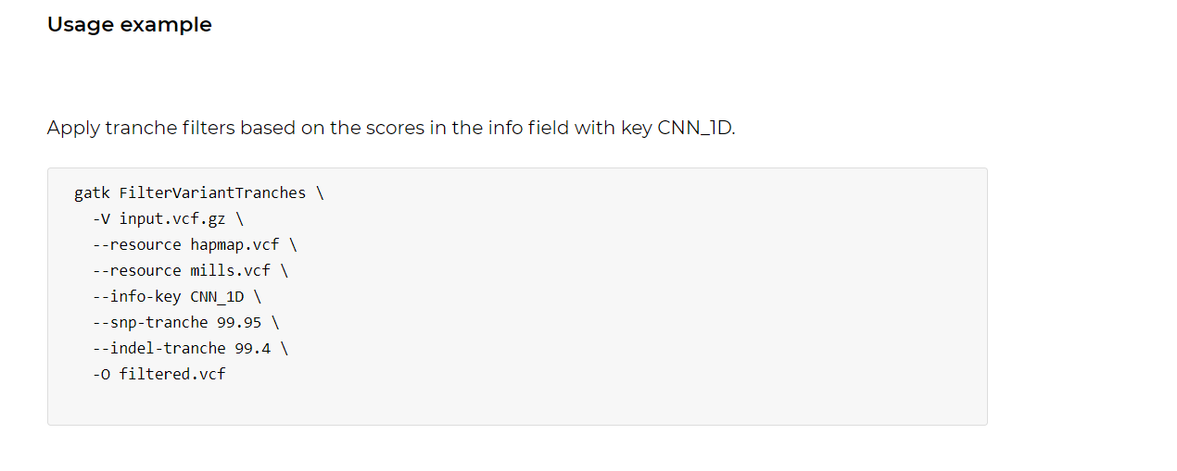
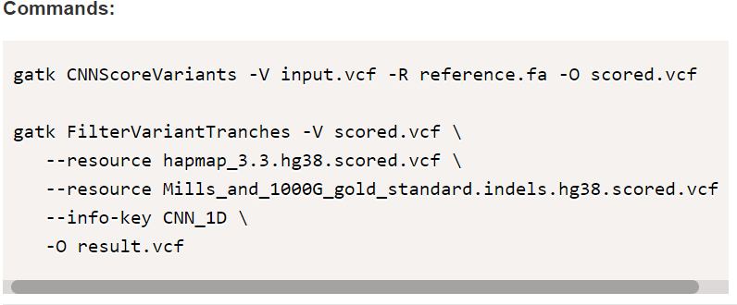
FilterVariantTranches. Resources.
https://gatk.broadinstitute.org/hc/en-us/community/posts/360056456092-FilterVariantTranches-User-error
b) the command used: gatk FilterVariantTranches -V vcf_cnn_annotated/TCGA-A2-A0ES_meig1_cnnAnno.vcf --resource hapmap_3.3.hg38.vcf.gz --resource Mills_and_1000G_gold_standard.indels.hg38.vcf.gz --info-key CNN_1D --snp-tranche 99.95 --indel-tranche 99.4 -O try/filtered3.vcf
https://www.biostars.org/p/452089/

Slide 81
hardFiltering
Parameter: germline_is_gene_panel
String SNP_DP = 6
String INDEL_DP = 32

Slide 82
Entendendo melhor os filtros
Hard-filtering germline short variants: https://gatk.broadinstitute.org/hc/en-us/articles/360035890471-Hard-filtering-germline-short-variants
(How to) Filter variants either with VQSR or by hard-filtering: https://gatk.broadinstitute.org/hc/en-us/articles/360035531112--How-to-Filter-variants-either-with-VQSR-or-by-hard-filtering
Hard-filtering germline short variants: https://gatk.broadinstitute.org/hc/en-us/articles/360035890471 , https://sites.google.com/a/broadinstitute.org/legacy-gatk-forum-discussions/methods-and-algorithms/6925-understanding-and-adapting-the-generic-hard-filtering-recommendations
I am unable to use VQSR (recalibration) to filter variants: https://gatk.broadinstitute.org/hc/en-us/articles/360037499012

Slide 83
Hard Filtering Parameters
QualByDepth (QD)
FisherStrand (FS)
StrandOddsRatio (SOR)
RMSMappingQuality (MQ)
MappingQualityRankSumTest (MQRankSum)
ReadPosRankSumTest (ReadPosRankSum)
SNP_DP = 6
INDEL_DP = 32
hardFilterSNP
hardFilterIndel
Notes:
A saida sao ao menos que cumpla

Slide 84
Filters for the variant calling
Hard filtering evaluated 7 standard GATK filters
Base-QRankSum
ReadPosRankSum (ReadPosRankSumTest )
ClippingRankSum
DP
MQ (RMSMappingQuality)
MQRank-Sum (MappingQualityRankSumTest)
GQ
3 extra filters
FS (FisherStrand)
ADT
ADTL
Notes:
Hard filtering evaluated 7 standard GATK filters (

Slide 85

Complement:
Hard-filtering germline short variants: https://gatk.broadinstitute.org/hc/en-us/articles/360035890471-Hard-filtering-germline-short-variants
Notes:
Qualidade das bases
Cobertura das bases
RMSMappingQuality (MQ): This is the root mean square mapping quality over all the reads at the site. Instead of the average mapping quality of the site, this annotation gives the square root of the average of the squares of the mapping qualities at the site. It is meant to include the standard deviation of the mapping qualities. Including the standard deviation allows us to include the variation in the dataset. A low standard deviation means the values are all close to the mean, whereas a high standard deviation means the values are all far from the mean.When the mapping qualities are good at a site, the MQ will be around 60.
Esta é a qualidade do mapeamento quadrado médio da raiz em todas as leituras no site. Em vez da qualidade média de mapeamento do local, essa anotação fornece a raiz quadrada da média dos quadrados das qualidades de mapeamento do local. Destina-se a incluir o desvio padrão das qualidades de mapeamento. Incluir o desvio padrão nos permite incluir a variação no conjunto de dados. Um desvio padrão baixo significa que os valores estão todos próximos da média, enquanto um desvio padrão alto significa que os valores estão todos longe da média. Quando as qualidades de mapeamento são boas em um local, o MQ será em torno de 60.
MappingQualityRankSumTest (MQRank-Sum):
This is the u-based z-approximation from the Rank Sum Test for mapping qualities. It compares the mapping qualities of the reads supporting the reference allele and the alternate allele. A positive value means the mapping qualities of the reads supporting the alternate allele are higher than those supporting the reference allele; a negative value indicates the mapping qualities of the reference allele are higher than those supporting the alternate allele. A value close to zero is best and indicates little difference between the mapping qualities.
Esta é a aproximação z baseada em u do teste de soma de classificação para qualidades de mapeamento. Ele compara as qualidades de mapeamento das leituras que suportam o alelo de referência e o alelo alternativo. Um valor positivo significa que as qualidades de mapeamento das leituras que suportam o alelo alternativo são maiores do que aquelas que suportam o alelo de referência; um valor negativo indica que as qualidades de mapeamento do alelo de referência são maiores do que aquelas que suportam o alelo alternativo. Um valor próximo de zero é o melhor e indica pouca diferença entre as qualidades de mapeamento.
ReadPosRankSumTest (ReadPosRankSum):
The last annotation we will look at is ReadPosRankSum. This is the u-based z-approximation from the Rank Sum Test for site position within reads. It compares whether the positions of the reference and alternate alleles are different within the reads. Seeing an allele only near the ends of reads is indicative of error, because that is where sequencers tend to make the most errors. A negative value indicates that the alternate allele is found at the ends of reads more often than the reference allele; a positive value indicates that the reference allele is found at the ends of reads more often than the alternate allele. A value close to zero is best because it indicates there is little difference between the positions of the reference and alternate alleles in the reads.
A última anotação que veremos é ReadPosRankSum. Esta é a aproximação z baseada em u do teste de soma de classificação para a posição do site nas leituras. Ele compara se as posições dos alelos de referência e alternativo são diferentes nas leituras. Ver um alelo apenas próximo ao final das leituras é indicativo de erro, porque é onde os sequenciadores tendem a cometer mais erros. Um valor negativo indica que o alelo alternativo é encontrado no final das leituras com mais frequência do que o alelo de referência; um valor positivo indica que o alelo de referência é encontrado no final das leituras com mais frequência do que o alelo alternativo. Um valor próximo de zero é melhor porque indica que há pouca diferença entre as posições dos alelos de referência e alternativos nas leituras.
FisherStrand (FS): This is the Phred-scaled probability that there is strand bias at the site. Strand Bias tells us whether the alternate allele was seen more or less often on the forward or reverse strand than the reference allele. When there little to no strand bias at the site, the FS value will be close to 0.
FS: Esta é a probabilidade em escala de Phred de que há tendência de fita no local. Strand Bias nos diz se o alelo alternativo foi visto com mais ou menos frequência na fita direta ou reversa do que o alelo de referência. Quando houver pouca ou nenhuma polarização de fita no local, o valor de FS será próximo de 0.

Slide 86

Extra filters
FS (FisherStrand (FS)) is the p-value from the contingency table of the number of reads calling the alleles at the variant site on either the DNA strands (forward and reverse).
ADT and ADTL evaluate imbalances in calling the reference and the alternative allele (ADT), also depending on the amount of reads that map on the variant locus (ADTL).
where AD1 and AD2 are the number of unfiltered reads calling the reference and alternate allele, respectively.
Descriptive statistics were performed using R 3.2.3 and the kruskal.test function, and ROCR library version 1.0-7.

Slide 87


QualByDepth (QD): variant confidence (from the QUAL field) divided by the unfiltered depth of non-hom-ref samples. This annotation is intended to normalize the variant quality in order to avoid inflation caused when there is deep coverage. For filtering purposes it is better to use QD than either QUAL or DP directly.
QD is to filter out variants with QD below 2. Why is that?
QD values distribution for unfiltered variants
QD values for variants that passed VQSR and those that failed VQSR
https://gatk.broadinstitute.org/hc/en-us/articles/360035890471-Hard-filtering-germline-short-variants

Slide 88
FisherStrand (FS)
This is the Phred-scaled probability that there is strand bias at the site. Strand Bias tells us whether the alternate allele was seen more or less often on the forward or reverse strand than the reference allele. When there little to no strand bias at the site, the FS value will be close to 0.
Note: SB, SOR and FS are related but not the same! They all measure strand bias (a type of sequencing bias in which one DNA strand is favored over the other, which can result in incorrect evaluation of the amount of evidence observed for one allele vs. the other) in different ways. SB gives the raw counts of reads supporting each allele on the forward and reverse strand. FS is the result of using those counts in a Fisher's Exact Test. SOR is a related annotation that applies a different statistical test (using the SB counts) that is better for high coverage data.
Our hard filtering recommendations tell us to fail variants with an FS value greater than 60.

Slide 89
StrandOddsRatio (SOR)
This is another way to estimate strand bias using a test similar to the symmetric odds ratio test. SOR was created because FS tends to penalize variants that occur at the ends of exons. Reads at the ends of exons tend to only be covered by reads in one direction and FS gives those variants a bad score. SOR will take into account the ratios of reads that cover both alleles.
hard filtering recommendation of failing variants with an SOR value greater than 3

Slide 90
RMSMappingQuality (MQ)
This is the root mean square mapping quality over all the reads at the site. Instead of the average mapping quality of the site, this annotation gives the square root of the average of the squares of the mapping qualities at the site. It is meant to include the standard deviation of the mapping qualities. Including the standard deviation allows us to include the variation in the dataset. A low standard deviation means the values are all close to the mean, whereas a high standard deviation means the values are all far from the mean.
When the mapping qualities are good at a site, the MQ will be around 60.

Slide 91
MappingQualityRankSumTest (MQRankSum)
This is the u-based z-approximation from the Rank Sum Test for mapping qualities. It compares the mapping qualities of the reads supporting the reference allele and the alternate allele. A positive value means the mapping qualities of the reads supporting the alternate allele are higher than those supporting the reference allele; a negative value indicates the mapping qualities of the reference allele are higher than those supporting the alternate allele. A value close to zero is best and indicates little difference between the mapping qualities.
Remember, our hard filtering recommendations are meant to be very lenient. If you do plot your annotation values for your samples and find none of your variants have MQRankSum less than -12.5, you may want to refine your hard filters. Our recommendations are indeed recommendations that you the scientist will want to refine yourself.
It is up to you to decide how many false positives you would like to remove from your dataset vs how many true positives you would like to keep and adjust your threshold based on that.

Slide 92

FilterMutectCalls
--autosomal-coverage | 0.0 | Median autosomal coverage for filtering potential polymporphic NuMTs when calling on mitochondria.
https://github.com/broadinstitute/gatk/blob/master/docs/mutect/mutect.pdf

Slide 93
FilterMutectCalls
https://github.com/broadinstitute/gatk/blob/master/docs/mutect/mutect.pdf

Slide 94
UPDATE
https://gatk.broadinstitute.org/hc/en-us/articles/360035531132--How-to-Call-somatic-mutations-using-GATK4-Mutect2

